Slide 1
Soundness problem for Resource-Constrained Workflow nets revisited
Natalia Sidorova and Christian Stahl

Slide 2
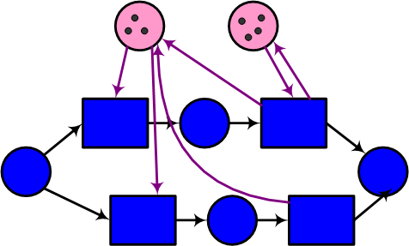
Resource-Constrained WF-nets (RCWF-nets)
Resource places P_{r}
Production net N_{p}
with production places P_{p}
P_{r}∩P_{p} =∅
i
f
A Petri net N with a set of places P_{p}∪P_{r} is an RCWF-net if its projection on P_{p} is a workflow net.

Slide 3
Mixable instances vs. independent instances
Instances in the production net can be independent, e.g. as in handling insurance claims
Or they can interfere with each other: produce a number of bicycles, all exactly the same, no matter which wheels go to which one…
For independent instances, we can introduce token id’s, and further reduce the model to classical Petri nets by substituting the production net by a state machine obtained from the reachability graph of the production net.
So in both cases we can just deal with classical Petri nets.

Slide 4
Different types of resources
Durable: machines, people
Consumable: paper, building materials, etc.
Producible: whatever you produce in your process
Shared: among different workflows
i
f

Slide 5
Different types of resources
Durable: machines, people
Consumable: paper, building materials, etc.
Producible: whatever you produce in your process
Shared: among different workflows
Environment
i
f

Slide 6
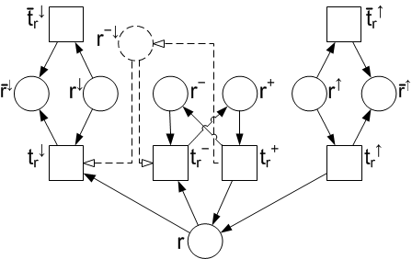
Modelling Environment

Slide 7
Modelling Environment
Lending/borrowing resources

Slide 8
Modelling Environment
Permanently adding resources

Slide 9
Modelling Environment
Permanently removing resources

Slide 10
Modelling Environment
Possibly extendable to model dependencies between the bounds, e.g. the total number of resources that can be removed permanently or temporarily

Slide 11
Modelling Environment
Configuration of the environment: the initial marking

Slide 12
A simple observation
Since borrowing is temporary—that is, under the fairness assumption, the environment will eventually return the borrowed resources—the choice of the initial marking for r⁻ does not change the set of markings reachable in the composition of the workflow and the environment projected on the workflow places: The workflow can always wait until the environment returns the resources borrowed and then proceed.
The same applies to lending resources.
Borrowing/lending can play a role if the process is timed.

Slide 13
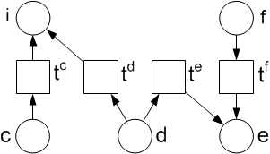
Generic case environment
Goal: create an arbitrary number of cases from the interval [k1, k2]
k1
k2
c – cases to create
d – cases possible to dismiss without creating
e – cases ended

Slide 14
Well-defined RCWF-net
The production net have no redundant places (i.e. P\{i} contains no proper siphons),
The production net is k-sound, for all m_{E}(c) ≤ k ≤ m_{E}(c) + m_{E}(d),
no resource tokens can be created by the WF-net (checked using the incidence matrix),
there exists a place invariant for the places c, d and e, guaranteeing that the number of instances remains constant
for every resource place, there exists a place invariant, guaranteeing that the number of resources remains constant

Slide 15
Formally…

Slide 16
Interval soundness
Let N be an RCWF-net and <E;m_{E}> be an environment of N such that N⊕E is well-defined. Then, N is sound with <E;m_{E}> if for all there is some
and
This definition captures many variants of interval soundness, under condition that the number of cases and the number of resources are bounded

Slide 17
Deciding soundness (1)

Slide 18
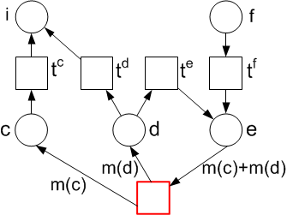
Deciding soundness (2)
The short-circuited net is live and bounded.

Slide 19
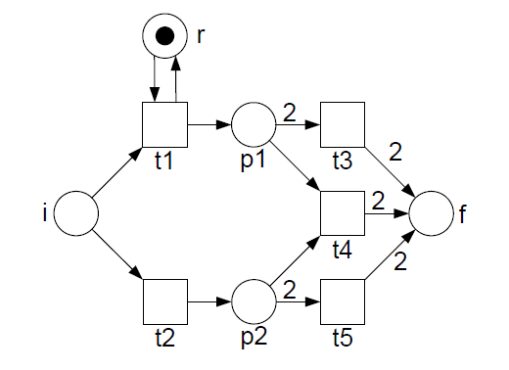
A side note
This does not hold for the “standard closure”:
The RCWF-net is not (3; 1)-sound: t1 t2 t4 t1 leads to deadlock [2f; p1], while the short-circuited net is bounded and live.

Slide 20
Repairing Interval Unsound RCWF-Nets
Construct a controller C that controls those transitions of N that produce tokens on or consume tokens from a resource place.
We assume the controller cannot control actions of the environment. (In case one would find it possible to control actions of the environment, our construction can be adapted by labeling certain transitions of E and adding those actions to the alphabet of C.)

Slide 21
Still to be investigated
Combining data and resources
Resources and configurability

