Slide 1
Process mining @ PwC PwC Belgium
www.pwc.com
TU/e, September 17th, 2015
Zbigniew ‘Zibi’ Paszkiewicz, Ph.D. Manager
System and Process Assurance
Data Assurance Group
zbigniew.paszkiewicz@be.pwc.com

Slide 2
Purpose
Explain evolution of process mining within PwC network
Present different applications areas
Discuss current PwC challenges
Discuss a link to open research questions

Slide 3
Agenda
1
Process mining @ PwC
2
Key application areas
3
Examples of projects and tools
4
Challenges
5
Link to research

Slide 4
Process mining @ PwC

Slide 5
Evolution across PwC network
PwC NL
Advisory
PwC PT
PwC DK
PwC DE
PwC NL
Forensic
PwC CH
PwC CA
PwC AU
PwC NL
Assurance
PwC BE
PwC UK
PwC SA
2013
2014
2015
Time

Slide 6
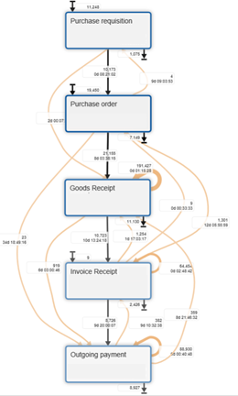
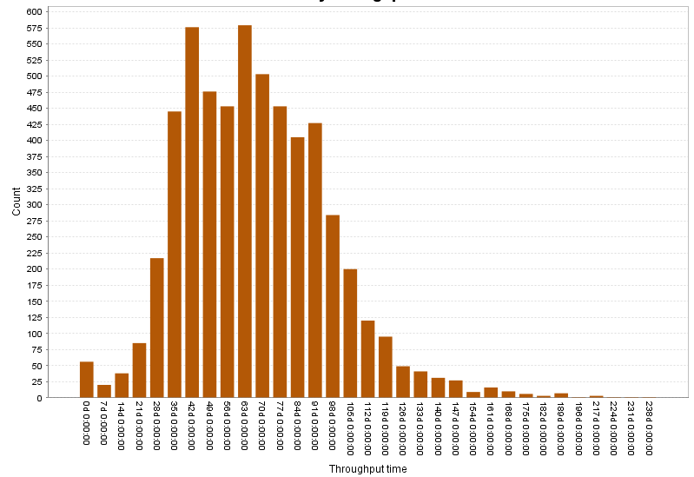
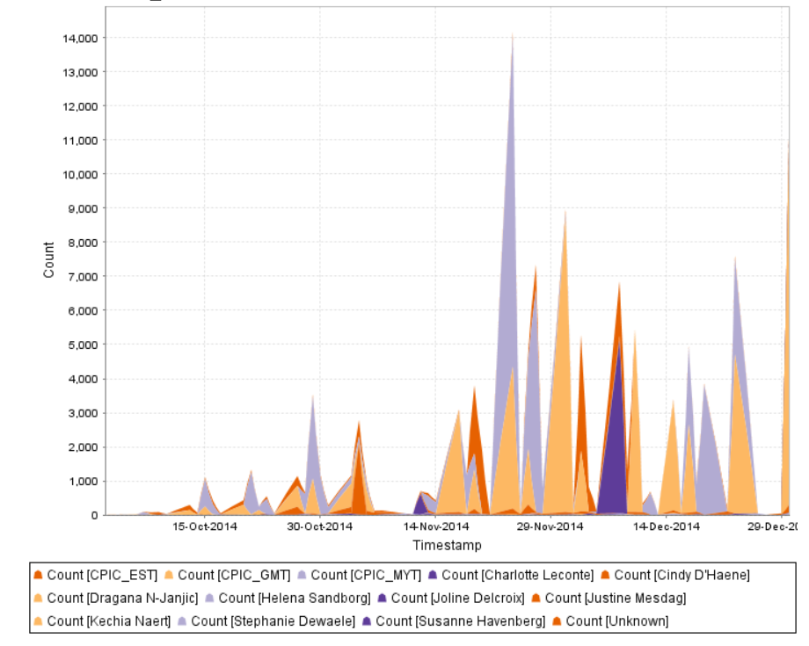
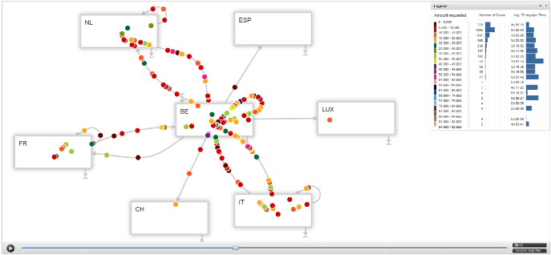
Narrow and broad definition
Narrow definition
Broad definition
Discovery of process models
Discovery of knowledge
Focus on process models
Focus on event logs
Purchase Order to Invoice average lead times
Notion of process

Slide 7
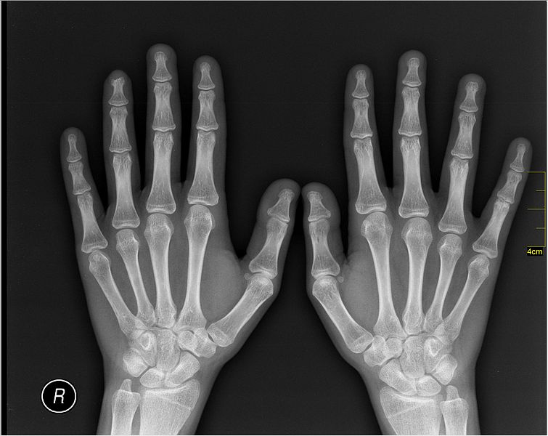
PwC Process Intelligence
Process Health Check
Process Insight
Process Monitoring
Process mining
Process mining
Notes:
In PwC approach we distinguish two phases of process analysis:
1. Process health Checks
2. Deep process insight
3. Process monitoring

Slide 8
Key application areas

Slide 9
Key application areas
1
2
3
Financial audit
Internal audit
Advisory
4
5
6
Tax and legal services
Implementation projects
Forensic services

Slide 10
Key application areas
1
2
3
Financial audit
Internal audit
Advisory
4
5
6
Tax and legal services
Implementation projects
Forensic services

Slide 11
Key application areas
1
2
3
Financial audit
Internal audit
Advisory
4
5
6
Tax and legal services
Implementation projects
Forensic services

Slide 12
Key application areas
1
2
3
Financial audit
Internal audit
Advisory
4
5
6
Tax and legal services
Implementation projects
Forensic services

Slide 13
Key application areas
1
2
3
Financial audit
Internal audit
Advisory
4
5
6
Tax and legal services
Implementation projects
Forensic services

Slide 14
Key application areas
1
2
3
Financial audit
Internal audit
Advisory
4
5
6
Tax and legal services
Implementation projects
Forensic services

Slide 15
Challenges

Slide 16
Key challenges
1
2
3
4
Project management
Analysis of ‘spaghetti’
processes
Completeness of analysis
Horizontal vs vertical development

Slide 17
Key challenges
1
2
3
4
Project management
Analysis of ‘spaghetti’
processes
Completeness of analysis
Horizontal vs vertical development

Slide 18
Cost of coming back
Team and needed competences Time management Budget management
Cost
Agile project management
Business understanding
Data understanding
Process mining
Evaluation
Deployment
Phases

Slide 19
Project scope
Reduce the cost of coming back
Hypothesis testing
Question-based projects
Problem-based projects
Data-based projects
Solution

Slide 20
Key challenges
1
2
3
4
Project management
Analysis of ‘spaghetti’
processes
Completeness of analysis
Horizontal vs vertical development

Slide 21
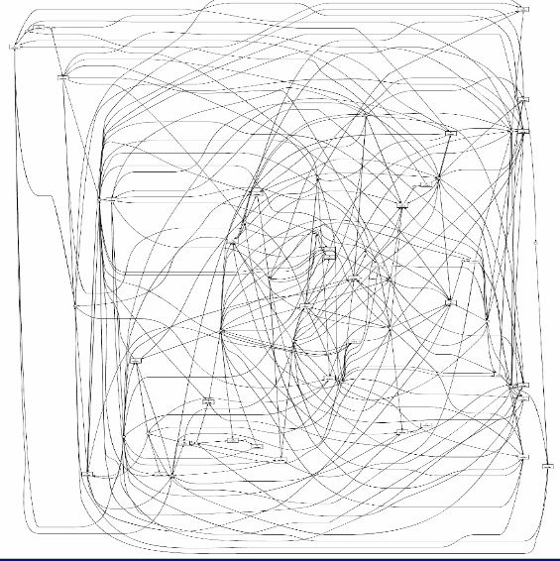
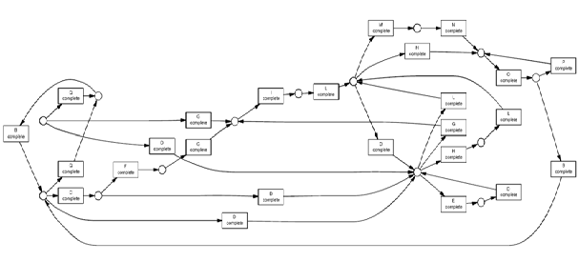
3. Spaghetti processes
Limit process complexity
Structured (Lasagna)
Unstructured (Spagetti)

Slide 22
Key challenges
1
2
3
4
Project management
Analysis of ‘spaghetti’
processes
Completeness of analysis
Horizontal vs vertical development

Slide 23
Key challenges
1
2
3
4
Project management
Analysis of ‘spaghetti’
processes
Completeness of analysis
Horizontal vs vertical development

Slide 24
Link to research

Slide 25
Selected areas of scientific research
1
2
Multi-dimensional process models
Inter-organizational configurable processes
3
4
Online predictions and recommendations
Clustering methods
(in audit context)

Slide 26
Selected areas of scientific research
1
2
Multi-dimensional process models
Inter-organizational configurable processes
3
4
Online predictions and recommendations
Clustering methods
(in audit context)

Slide 27
Organisations and processes
Activity
Activity
Activity
Activity
Activity
Activity
Activity
Activity

Slide 28
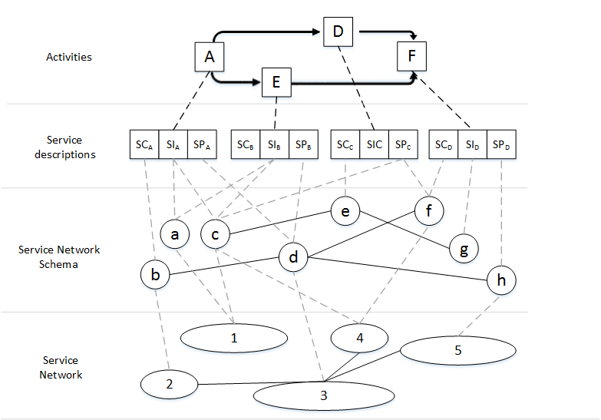
Picard, W., A Formalization of Social Requirements for Human Interactions with Service Protocols, in: Information Sciences, vol. 283 , Elsevier, 2013

Slide 29
Selected areas of scientific research
1
2
Multi-dimensional process models
Inter-organizational configurable processes
3
4
Online predictions and recommendations
Clustering methods
(in audit context)

Slide 30
Selected areas of scientific research
1
2
Multi-dimensional process models
Inter-organizational configurable processes
3
4
Online predictions and recommendations
Clustering methods
(in audit context)

Slide 31
PwC Process Intelligence
Process Health Check
Process Insight
Process Monitoring
Process mining
Process mining
Process mining
Notes:
In PwC approach we distinguish two phases of process analysis:
1. Process health Checks
2. Deep process insight
3. Process monitoring

Slide 32
Selected areas of scientific research
1
2
Multi-dimensional process models
Inter-organizational configurable processes
3
4
Online predictions and recommendations
Clustering methods
(in audit context)

Slide 33
Conclusions

Slide 34
Conclusions
Process mining is a universal approach used as a part of many PwC services
Process mining is not a standalone service itself
Key challenges are linked to management of process mining project complexity – it is not the analysis that is complex
Many approaches under development to address key project challenges and demonstrate value to client
Rapidly developing area – practice closely linked to research

Slide 35
Thank you!
Zbigniew Paszkiewicz, Ph.D. Manager
zbigniew.paszkiewicz@be.pwc.com Mobile: +32 491 62.17.81
System and Process Assurance
Data Assurance Group
LinkedIn: https://www.linkedin.com/in/zpaszkiewicz Research Gate: http://www.researchgate.net/profile/Zbigniew_Paszkiewicz/
© 2015 PricewaterhouseCoopers. All rights reserved. “PricewaterhouseCoopers” refers to the network of member firms of PricewaterhouseCoopers International Limited, each of which is a separate and independent legal entity.

