Slide 1
Context-Aware Performance Analysis
Bart Hompes
b.f.a.hompes@tue.nl
Joos Buijs,
Wil van der Aalst

Slide 2
Event log
Process
Discovery

Slide 3
Event log
Process
Model
Conformance
Checking

Slide 4
Event log
Process
Model
Performance
Analysis

Slide 5
However
NONETHELESS
ALTHOUGH

Slide 6
Motivating example
Case | Activity | Duration | Resource
1 | A | 75 min | John
1 | B | 5 min | Bob
1 | C | 23 min | Sue
2 | A | 17 min | Bob
2 | B | 8 min | John
2 | C | 26 min | Sue
3 | A | 73 min | John
3 | B | 6 min | Bob
4 | A | 14 min | Bob
4 | B | 4 min | John
5 | A | 19 min | Bob
… | … | … | …

Slide 7
Motivating example
Case | Activity | Duration | Resource
1 | A | 75 min | John
1 | B | 5 min | Bob
1 | C | 23 min | Sue
2 | A | 17 min | Bob
2 | B | 8 min | John
2 | C | 26 min | Sue
3 | A | 73 min | John
3 | B | 6 min | Bob
4 | A | 14 min | Bob
4 | B | 4 min | John
5 | A | 19 min | Bob
… | … | … | …
Average:
Total: 39,6 min.

Slide 8
Motivating example
Case | Activity | Duration | Resource
1 | A | 75 min | John
1 | B | 5 min | Bob
1 | C | 23 min | Sue
2 | A | 17 min | Bob
2 | B | 8 min | John
2 | C | 26 min | Sue
3 | A | 73 min | John
3 | B | 6 min | Bob
4 | A | 14 min | Bob
4 | B | 4 min | John
5 | A | 19 min | Bob
… | … | … | …
Average:
John: 74 min.
Bob: 16,7 min.
Total: 39,6 min.
Variance:
John: 2 min.
Bob: 6,3 min.
Total: 989,8 min.

Slide 12
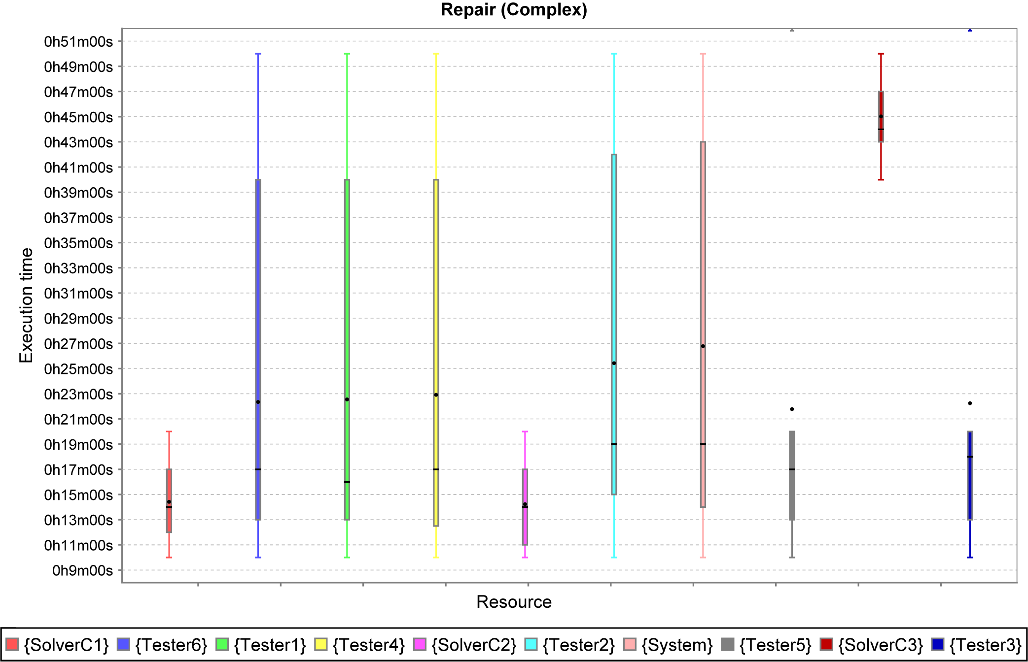
Process entity
Desired output
Performance
measure
Context
Notes:
many clusters because snapshot of entire history

Slide 13
Select process entities
Map entities to context
Event log
Show results
Perform
significance
tests
Measure
entity performance
© Icons by FlatIcon

Slide 14
Select process entities
Process entities are collection of events.
Entities can be
Cases
Activity instances
Resources
Events
Goal: To select relevant entities

Slide 15
Map entities to context
Context can be anything!
Executing resource
Prefix in trace
Case load at time of event
Time of day
Day of week
Temperature in office MF 7.060
Goal: To find differences circumstances for execution of activity

Slide 16
Measure entity performance
Performance functions are only
applicable to certain process entities.
For example
Duration (case, activity instance)
Utilization (resource)
Cost (event, activity, case, resource)
Waiting time (activity instance)
Goal: To measure performance of process entities in different contexts

Slide 17
Motivating example
Case | Activity | Duration | Resource
1 | A | 75 min | John
1 | B | 5 min | Bob
1 | C | 23 min | Sue
2 | A | 17 min | Bob
2 | B | 8 min | John
2 | C | 26 min | Sue
3 | A | 73 min | John
3 | B | 6 min | Bob
4 | A | 14 min | Bob
4 | B | 4 min | John
5 | A | 19 min | Bob
… | … | … | …
Entity
Activity A
Context
Resource
Performance
Duration

Slide 18
Select process entities
Map entities to context
Event log
Show results
Perform
significance
tests
Measure
entity performance
© Icons by FlatIcon

Slide 19
Perform significance tests
Hypothesis: measurements come from the same distribution
Reject: the context might explain the difference
Goal: To find significant differences in performance for different contexts

Slide 20
ANOVA
Analysis of variance
Every context is considered a sample
Null hypothesis: all sample means are equal

Slide 21
ANOVA
Analysis of variance
Assumptions
Normality
Homogeneity of variance
Independence of observations
Used tests
One-way ANOVA
Kruskall-Wallis (non-parametric alternative)

Slide 22
Post Hoc Test
Used tests
Tukey’s range test
Nemenyi’s test (non-parametric alternative)
Notes:
Note multiple comparison correction can lead to rejection of anova null hypothesis but no significant differences in post hoc. Very little chance, and no real-world impact of those ‘differences’.

Slide 23
Show results
Show significant differences, either as text or graphically.
“There’s a statistically significant difference in the time that John takes to execute activity A compared to the time Bob takes”
“John is twice as slow as Bob in executing activity A”

Slide 24
Show results
Post Hoc results
(Solver C1, Solver C3)
(Solver C2, Solver C3)

Slide 25
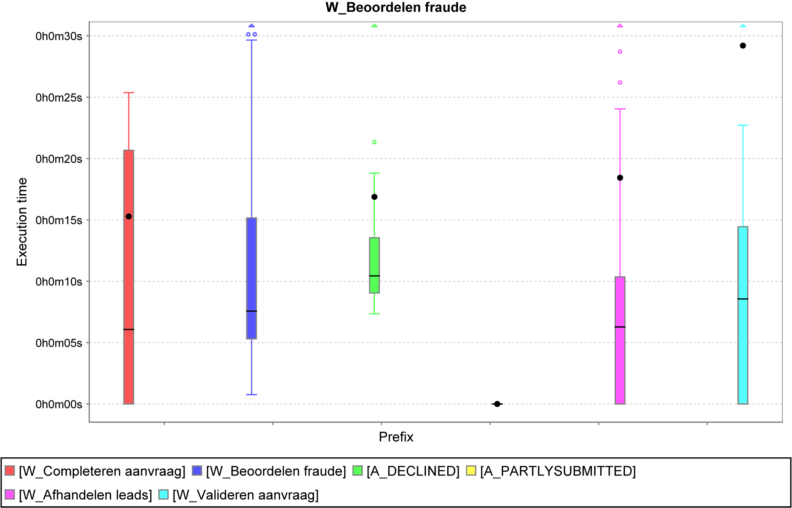
Show results

Slide 26
Show results

Slide 27
Show results

Slide 28
Select process entities
Map entities to context
Event log
Show results
Perform
significance
tests
Map
entities to performance
© Icons by FlatIcon

Slide 29
Related work
Context-Aware clustering techniques
Separate data & learn individual prediction models
Remaining running time prediction
Usually rely on process model or do not use context
Classification / decision tree learning
Decide on (in)dependent variable, unclear significance / impact
Simulation
Base model should represent reality

Slide 30
Downsides
Combined effect of multiple contexts has to be tested explicitly
Increases the number of tests
Outliers can affect test results
Filter out or keep?
Significance does not equal real-world impact
Some discovered differences might not matter in reality

Slide 31
Future work
Add functionality
More contexts and performance metrics
Integrate impact
Significance $≠$ impact
Use in streaming context
Monitoring for changes
Prediction
How can my process be optimized?

Slide 32
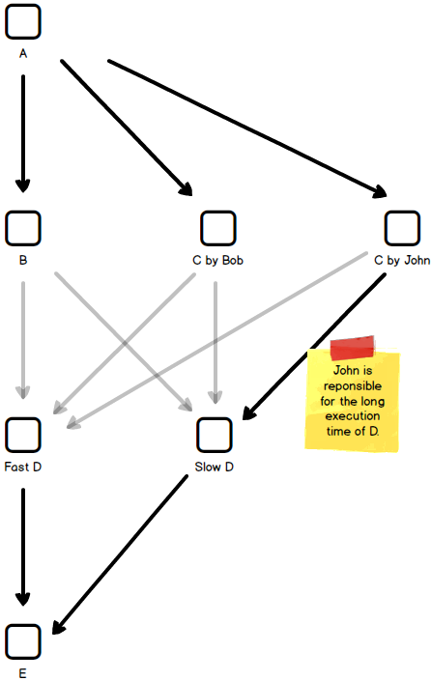
Idea
Split activities in model
That have the biggest differences / impact

Slide 33
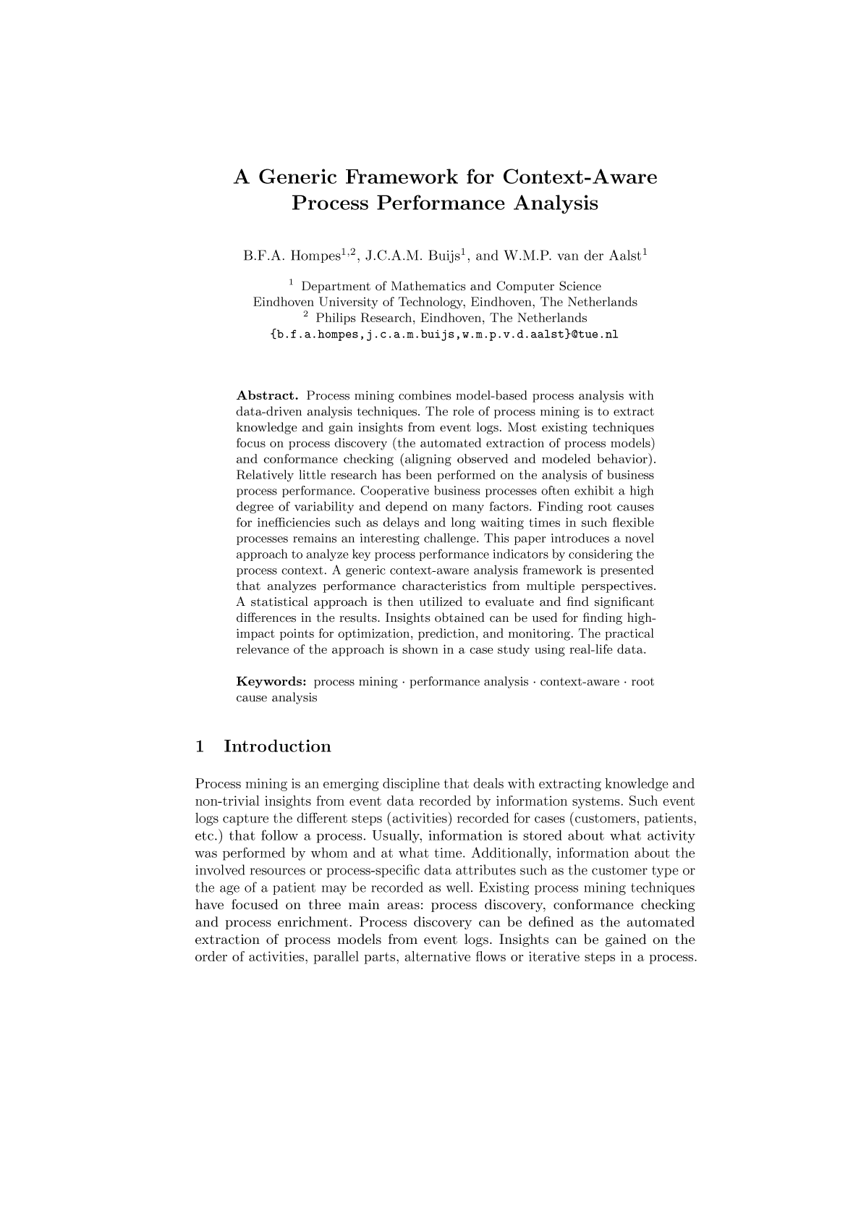
A Generic Framework for Context-Aware Process Performance Analysis
Bart Hompes, Joos Buijs, Wil van der Aalst
CoopIS 2016

