Slide 1
Data Conformance Checking using Optimal Alignments
Felix Mannhardt, Massimiliano de Leoni, Hajo A. Reijers

Slide 2
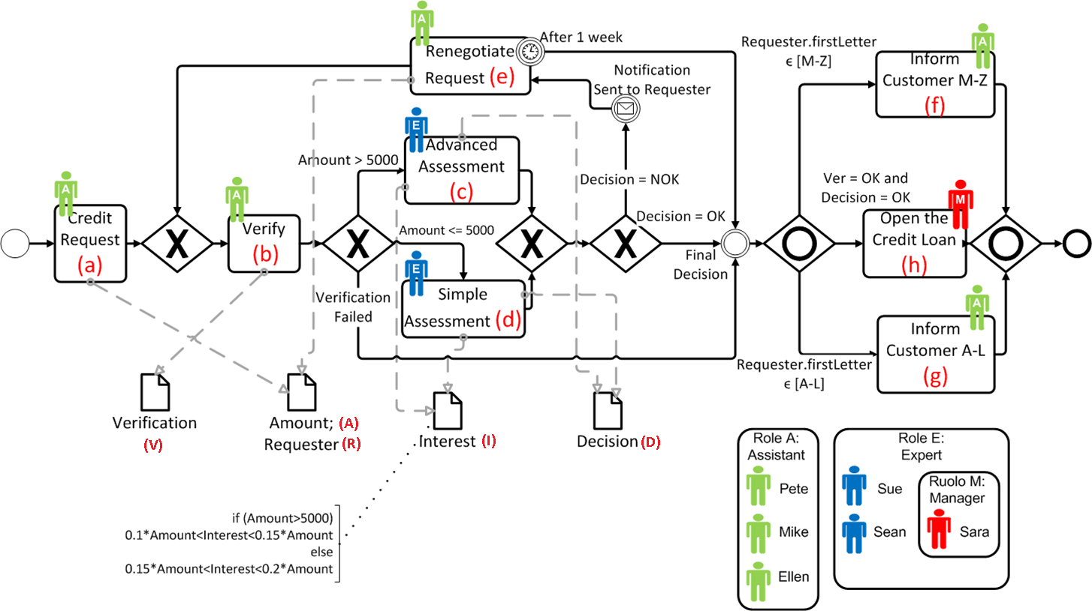
Problem (Adapted from Massimiliano de Leoni)
Activity d should have occurred, since amount < 5000
(a; {A = 3000;R = Michael; E = Pete});
(b; {V = OK;E = Sue});
(c; {I = 530;D = OK;E = Sue});
(f; {E = Pete});
Activity h hasn’t been executed: D cannot be «OK»
(a; {A = 3000;R = Michael; E = Pete});
(b; {V = OK;E = Sue});
(c; {I = 530;D = OK;E = Sue});
(f; {E = Pete});
(a; {A = 5001;R = Michael; E = Pete});
(b; {V = OK;E = Pete});
(c; {I = 530;D = NOK;E = Sue});
(f; {E = Pete});
«Sue» not authorized to perform b: is not Assistant

Slide 3
How Does Data Alignment Work?
Petri Nets with Data:
Two new “Moves” with associated “Costs”:
Move with incorrect write operation
Move with missing write operation
Formulation of an MILP problem for CF Alignment:
$min {\hat{x}}_{1}$
$x−{M\hat{x}}_{1}≤2000 ∧−x−{M\hat{x}}_{1}≤−2000 ∧x≥5000$
${\hat{x}}_{1}∈\left\{0,1\right\}, x ∈ℤ$
$$X<5000$$
B
A
D
$$X≥5000$$
C
X
$${+cost(missing)=κ}_{DA}$$
[1] M. de Leoni, W. M. P. van der Aalst (2103). Aligning Event Logs and Process Models for Multi-Perspective Conformance Checking: An Approach Based on Integer Linear Programming. [2] A. Adriansyah, B. F. van Dongen, W. M. P. van der Aalst (2011). Conformance checking using cost-based fitness analysis.

Slide 4
Current Data Conformance Checker in ProM
Input
Output
Petri Net with Data
Data Conformance Checking
Data Alignment
Event Log
Cost
Control Flow Alignment
Data Alignment

Slide 5
Shortcomings of the Current Solution
(a; {A = 3000;R = Michael});
(b; {V = NOK});
(c; {I = 530;D = OK});
(f);
Perfect CF Alignment ($κ_{CA}=0$)
L | a | b | c | f
P | a | b | c | f
Resulting DF Alignment ($κ_{DA}=3$)
(a; {A = 5001; R = Michael});
(b; {V = OK});
(c; {I = 530;D = NOK});
(f);
Better DF Alignment ($κ_{CA}=1$)
(a; {A = 3000;R = Michael});
(b; {V = NOK});
(c; {I = 530;D = OK});
(f);

Slide 6
First Idea (Multi-Alignment Approach)
Input
Output
Petri Net with Data
Data Conformance Checking
Optimal Data Alignment
Event Log
Yes
Optimal?
No
Cost
$$κ_{CA}≥Κ_{BestSoFar}$$
OR
$$κ_{DA}=0$$
Control Flow Alignment
Data Alignment
Cache
Image source: http://commons.wikimedia.org/wiki/File:Pictofigo_-_Idea.png

Slide 7
Second Idea (Single-Alignment Approach)
(a; {A = 3000;R = Michael});
(b; {V = NOK});
(c; {I = 530;D = OK});
(f);
($κ_{CA}$,$κ_{DA}$)
<>
Move in Log
Move in Model
Move in Both
<a>
<a>
<a>
Move in Log
Move in Both
(0,0)
<a,b>
…
<a,b>
…
Move in Log
(1,0)
Move in Both
(0,2)
<a,b,c>
<a,b,c>
(1,0)
Move in Both
<a,b,c,f>
Image source: http://commons.wikimedia.org/wiki/File:Pictofigo_-_Idea.png

Slide 8
Single-Alignment Approach I
For each node in the search space
Compute a Data Alignment (MILP) for the prefix
Remember $κ_{DA}$ and the variable assignment
Use the variable assignment to check if an MILP needed
A best-first search on the overall cost ($κ_{DA}+κ_{CA}$) returns one optimal Data Alignment
Use of ILP heuristic for A* [2] still possible
$κ_{DA}+κ_{CA}$ never gets better (no negative edges!)
But, our search space is bigger!
[2] A. Adriansyah, B. F. van Dongen, W. M. P. van der Aalst (2011). Conformance checking using cost-based fitness analysis.

Slide 9
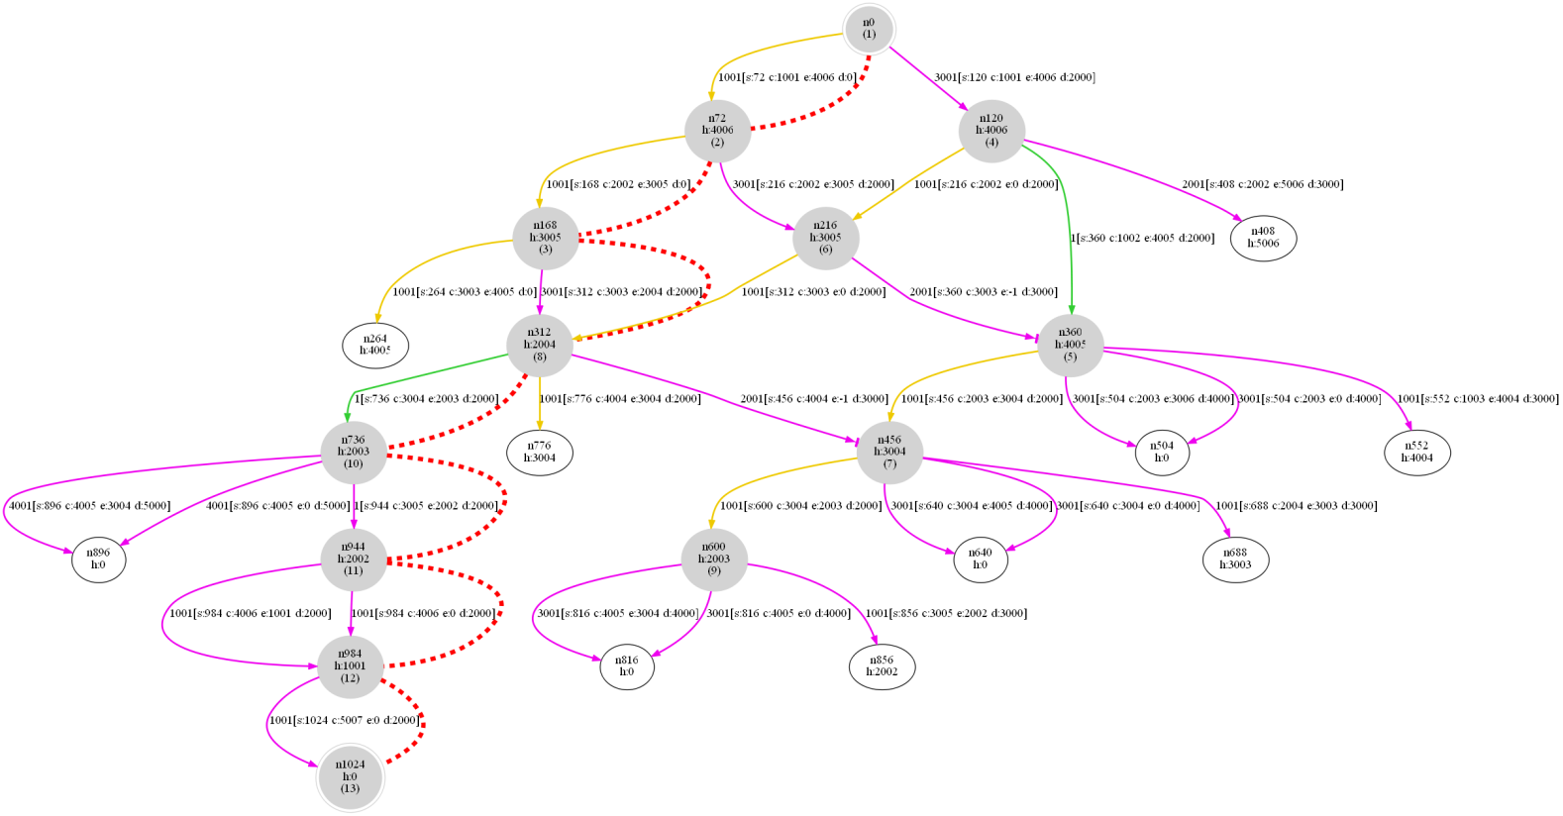
Single-Alignment Approach: Search Space
Two states are equivalent iff
Same marking of “Event Net” & Process Model as in [2]
Same variable assignment wrt. all guards
(a; {A = 5001;R = Michael});
(b; {V = OK});
(c; {I = 530;D = OK});
(c; {I = 530;D = NOK});
(f);
(a; {A = 5001;R = Michael});
(b; {V = OK});
(c; {I = 530;D = OK});
(c; {I = 530;D = NOK});
(f);
vs.
[2] A. Adriansyah, B. F. van Dongen, W. M. P. van der Aalst (2011). Conformance checking using cost-based fitness analysis.

Slide 10
Comparison: Improvement of Fitness
254 Traces
2 Traces

Slide 11
Comparison: Dutch Insurance Institute

Slide 12
Comparison: Dutch Insurance Institute [1]
[1] M. de Leoni, W. M. P. van der Aalst (2103). Aligning Event Logs and Process Models for Multi-Perspective Conformance Checking: An Approach Based on Integer Linear Programming.

Slide 13
Comparison: Dutch Insurance Institute

Slide 14
Comparison: Synthetic Model (10% Noise)

Slide 15
Comparison: Synthetic Model (10% Noise)

Slide 16
Comparison: Synthetic Model (10% Noise)

Slide 17
Comparison Wrap-up
Multi-Alignment Approach
Building CF Alignments (sorted) up to a certain $κ_{CF}$ is not feasible for certain models/traces
Though faster in some cases (Good Fitness)
Single-Alignment Approach
Again, solving many (smaller) MILPs
Integrated Optimizations:
Check if guards already fulfilled ➔ No MILP
Check if only write operations missing ➔ No MILP
Re-use calculated Data Alignments ➔ 1 x MILP

Slide 18
What Next?
Improve the Implementation
Faster MILP solving by re-use the lpsolve instance?
Reduce memory footprint of both approaches?
Will a Decomposition of the process model help?
Case study with Event Log from Italian local police
Event Log about the management of road-traffic fines
Process with multiple decision points
Process with non-trivial guards
Event Log contains data attributes
Submit Paper to FASE 2014

Slide 19
Summary
Current Data Alignment could be sub-optimal
Two approaches for an optimal Data Alignment
Multi-Alignment Approach
Single-Alignment Approach
Both implemented in ProM
Soon to be integrated in Data Aware Replayer
Which one to use depends on the case
CF Alignment
CF Alignment
CF Alignment
CF Alignment
…
Optimal?
Data Alignment
MILP
MILP
MILP
MILP
Best First Search
Data Alignment

Slide 20
Image source: http://commons.wikimedia.org/wiki/File:Pictofigo_-_Idea.png

