Slide 1
Efficiency of Alignment-based algorithms
(Gu)estimation!
Laziness!
Implementation effort?
B.F. van Dongen

Slide 2
Introduction: Alignments
Alignments are used for conformance checking
Alignments are computed over a trace and a model:
A trace is a (partial) order of activities
A model is a labeled Petri net or a labeled Process Tree, labeled with activities
An alignment explains exactly where deviations occur:
A synchronous move means that an activity is in the log and a corresponding transition was enabled in the model
A log move means that no corresponding activity is found in the model
A model move means that no corresponding activity appeared in the log

Slide 3
Implementations: Estimator versions
Petri nets
Process Trees
Dijkstra (estimator 0)
Naive (estimator parikh)
ILP (estimator using ILP)
Naive (estimator parikh)
LP (estimator using LP)
Hybrid ILP (ILP & LP)
(I)LP with OR constraints

Slide 4
Complexity w/ Own Collections
O(log(n)+k/n)
Initialize PriorityQueue q
While (head(q) is not target t)
VisitedNode n = head(q)
add n to the considered nodes
For each edge in the graph from node(n) to m
If m was considered before, continue
If m is in the queue with lower cost, continue
If m is in the queue with higher cost, update and reposition it
If m is new,
compute an estimate for the remaining distance to t
V = new VisitedNode(m)
set n a predecessor for v
add v to the priority queue
Return head(q)
O(log(n)+k/n)
O(1)
O(1)
O(log(n))
Expensive?
O(log(n)+k/n)

Slide 5
A Closer Look: Estimation
Necessary to compute fast
Stupid estimation: Trivial
Smarter estimation: Trivial
LP-based estimation: Polynomial
Minimize c.x Where A.x r c.x >= c.x’
ILP-based estimation: Exponential
=
≤
Virtually no difference in practice

Slide 6
Cached Estimates
Initialize PriorityQueue q
While (head(q) is not target t)
VisitedNode n = head(q)
add n to the considered nodes
For each edge in the graph from node(n) to m
If m was considered before, continue
If m is in the queue with lower cost, continue
If m is in the queue with higher cost, update and reposition it
If m is new,
compute an estimate for the remaining distance to t
v = new VisitedNode(m)
set n a predecessor for v
add v to the priority queue
Return head(q)

Slide 7
Cached Estimates
Initialize PriorityQueue q
While (head(q) is not target t)
VisitedNode n = head(q)
If the estimate for node(n) is not exact yet
Compute the exact estimate for the remaining distance to t and
add n to the priority queue
continue
add n to the considered nodes
For each edge in the graph from node(n) to m
If m was considered before, continue
If m is in the queue with lower cost, continue
If m is in the queue with higher cost, update and reposition it
If m is new,
compute a fast lowerbound for the remaining distance to t
v = new VisitedNode(m)
set n a predecessor for v
add v to the priority queue
Return head(q)
O(log(n)+k/n)
Expensive?
O(log(n)+k/n)
O(1)

Slide 8
Cached Estimates
The number of computed estimates decreases
Worst case is equal
The number of queue operations increases
Worst case is double (queue, poll, requeue, poll)
Storage mechanism has to allow for overwriting of estimates
Loss of space

Slide 9
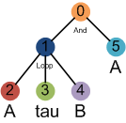
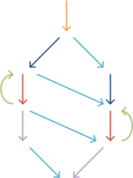
State space reduction
Example:
Trace: < A, A, B, A >
Statespace of the model:
A
A
B
9 states,
13 transitions

Slide 10
Alignment search space
45 states,
121 transitions
Find the shortest path from the top-left to the bottom right

Slide 11
Alignment search space
The alignment for trace <A, A, B, A>:
< (0,–), (1,–), (2, A), (3,–), (2,A), (4,B), (5,A) >

Slide 12
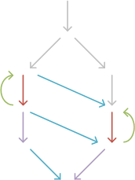
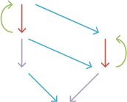
Implicit Execution
In a Process Tree, many nodes can be executed implicitly
A
A
B
6 states,
9 transitions

Slide 13
Implicit execution – Statespace reduction
45 30 states,
121 86 transitions

Slide 14
Visited Statespace –Estimators
Trivial estimator: Remaining trace length
45 30 21 states,
121 86 32 transitions
(I)LP Based Estimator
45 30 21 21 states,
121 86 32 30 transitions

Slide 15
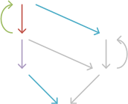
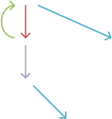
Stubborn Sets
Stubborn sets can be used to eliminate parallelism while maintaining reachability of deadlocks
Basically, you sequentialize as much of the parallelism as possible
5 states,
5 transitions

Slide 16
Stubborn Sets for Alignments
Model Moves can completely be sequentialized
Allow for all possible Model Moves after a Synchronous Move and after a Log Move
Otherwise, allow only mutually dependent moves, and independent moves “larger” than the last Model Move.
Special care has to be taken of loops
Allow moves from within the last started subtree only
Moves are dependent iff:
Their direct parent is a XOR node
Their direct parent is a LOOP node
One move is an OR-termination of the other node’s parent

Slide 17
Performance comparison
Notes:
20,000 exact estimates / second

Slide 18
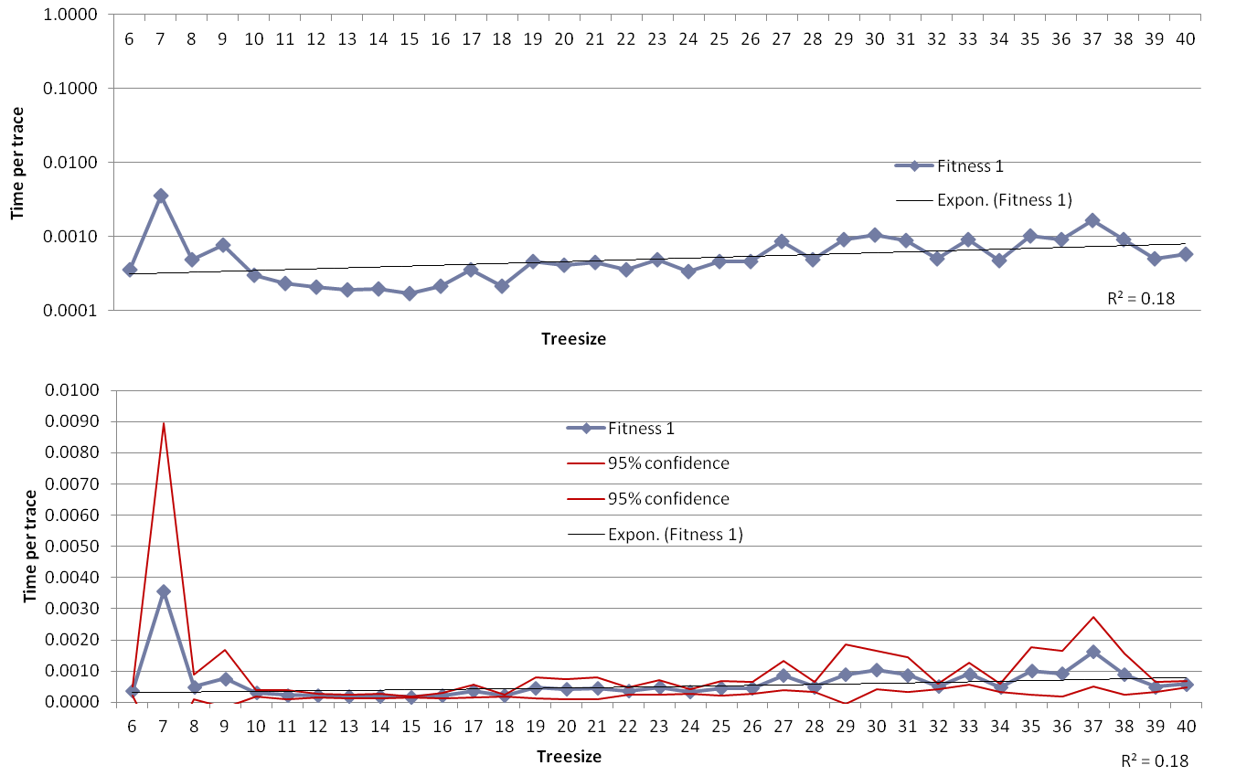
Hybrid ILP with Stubborn Sets (fitness 1)

Slide 19
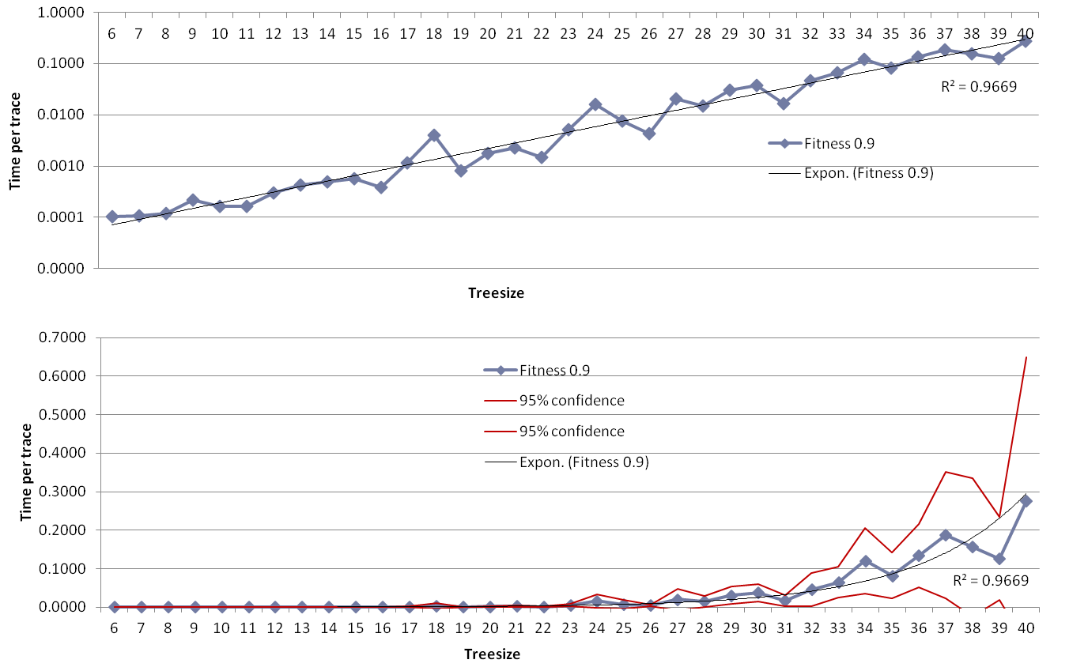
Hybrid ILP with Stubborn Sets (fitness 0.9)

Slide 20
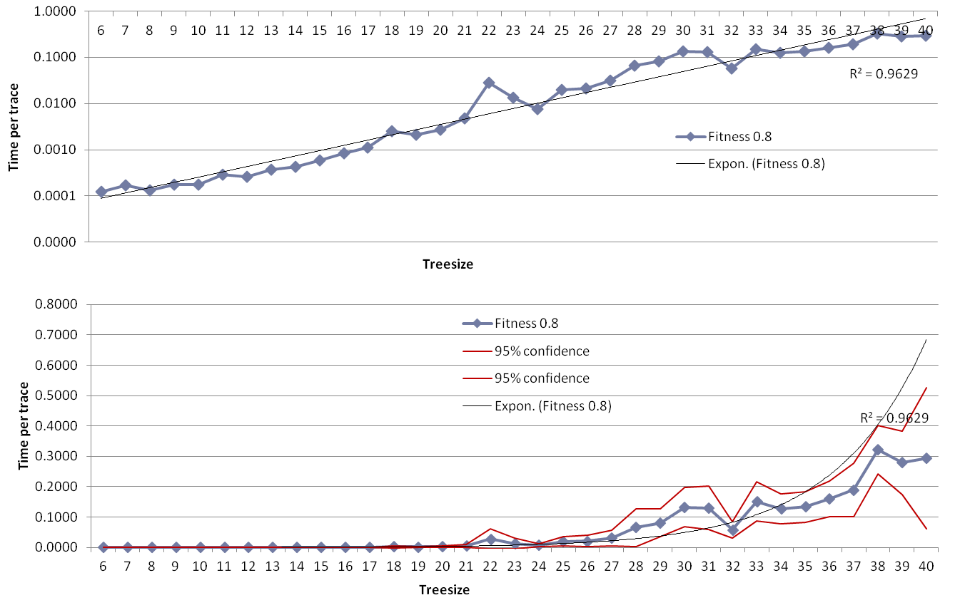
Hybrid ILP with Stubborn Sets (fitness 0.8)

Slide 21
Bottlenecks
Estimation is no longer the (only) bottleneck
LP computations are done in native code
data transfer between Java and native code is expensive
LP solvers are optimized for few, very large problems, while we have very many very small problems (20,000 per second)
Queue operations become expensive
Worst case doubling queue operations
For large models, queues get large
Considered node set operations become expensive
Large statespaces imply many considered states

Slide 22
Future work
Approximation of alignments:
Fixed-size queues allow for quick queue operations, but uncertain results
Efficient estimation:
Estimation is exponential in the size of the model
Doing multiple estimates at once, or
reusing previous estimates
Modularization:
Exploit the block structure even more

