Slide 1
History-based Construction of Log-Process Alignments for Conformance Checking
Mahdi Alizadeh
Massimiliano de Leoni
Nicola Zannone
{m.alizadeh,m.d.leoni,n.zannone}@tue.nl

Slide 2
Agenda
Alignment
History-Aware Conformance Checking
Evaluation
Future Works

Slide 3
Alignment
History-Aware Conformance Checking
Evaluation
Future Works

Slide 4
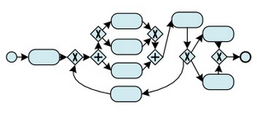
Alignment
Identifying nonconformity between a trace and model
Each trace has several alignments
Cost function Optimal alignment

Slide 5
Cost functions
Two types of cost functions
Computing an optimal alignment
Measuring the severity of deviations
Existing approaches for defining a cost function:
Background knowledge of process analysts
Not trivial and time-consuming
Based on the human judgment
Standard cost function

Slide 6
Standard Cost Function
Penalizes every deviation equally
Not realistic
Trace: A D
B
E
A
C
D
5%
Trace | A | >> | D
Net | A | C | D
Simplest explanation for non-conformity
Trace | A | >> | >> | D
Net | A | B | E | D
The most probable explanation for non-conformity

Slide 7
Alignment
History-Aware Conformance Checking
Evaluation
Future Works

Slide 8
History-aware cost function
Challenge:
Use objective factors
Automatically compute the cost of movements
Find the most probable explanation of non-conformity
Solution: Analyzing past process executions to define the cost function
Activity Names
Time
Data attributes
Resource
….
Control Flow

Slide 9
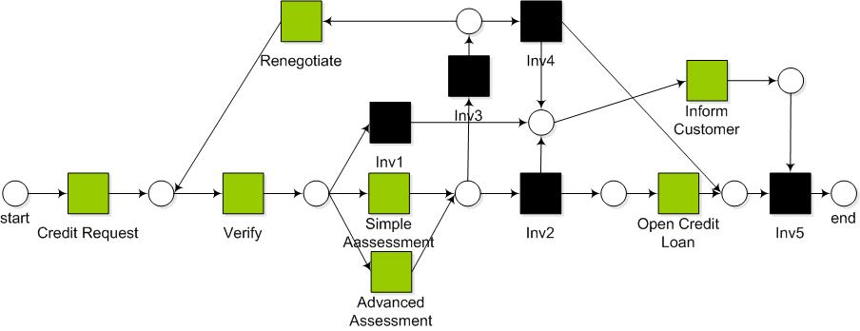
Computing the Cost of an Alignment Move
R
I₄
I₃
I
I₁
C
V
S
I₂
O
I₅
σ₂
A
σ₁: C V S R V O
(O, >>)
(>>,S)
(>>,A)
….
Trace | C | V | S | >> | R | V
Net | C | V | S | I₃ | R | V
Computing
Probabilities
Cost Profile Function
Cost of alignment moves
State Representation Function
State of the system

Slide 10
Step-1: State Representation Function
Different functions can be used to characterize the state of the system
Abstraction Type | Order of activity | # of occurrences of activities | occurrences of activities
Sequence
Multi-set
Set
Based on the function, different traces can be mapped onto
the same state
{C,V,S,R}
Set
σ₁= CVSRVSR
{C,V,S,R}
Example:
{C(1), V(2), S(2), R(2)}
σ₂= CVSRV
Multi-set
{C(1), V(2), S(1), R(1)}

Slide 11
Step-2: Probability of Different Alignment Moves
Move on model (>>, a)
We expected to see an activity “a” in the next step
Probability that an activity occurs after reaching certain state
Move on Log (a, >>)
Unexpected activity was executed
Probability that an activity never eventually occurs after reaching certain state
Trace | #
C V S R V S I O | 700
C V S R V S I | 200
C V S R V A I O | 10
C V S R V A I | 90
Move on model
(>>, S)
State₁: C V S R V
(S, >>)
Move on log

Slide 12
Step-3: Cost Profile
Cost Profiles
f₁(p)=1/p
f₂(p)=1+log(1/p)
Move on model
f₁(p) = 1.11
(>>, S)
f₂(p) = 1.04
State: C V S R V
f₁(p) = 10
(S, >>)
f₂(p) = 2
Move on log
f₁(p) penalizes less probable moves much more than f₂(p)

Slide 13
Discussion: Cost Profile
The selection of the cost profile has a significant impact on the results
Which alignment should be considered as an optimal alignment?
f₁(p)=1/p
σ₁: X Y
A₁
…
A₅₀
99%
X
Y
1%
B
f₂(p)=1+log(1/p)
Tradeoff:
Frequency of the traces in historical logging data
Number of deviations in alignments

Slide 14
Alignment
History-Aware Conformance Checking
Evaluation
Future Works

Slide 15
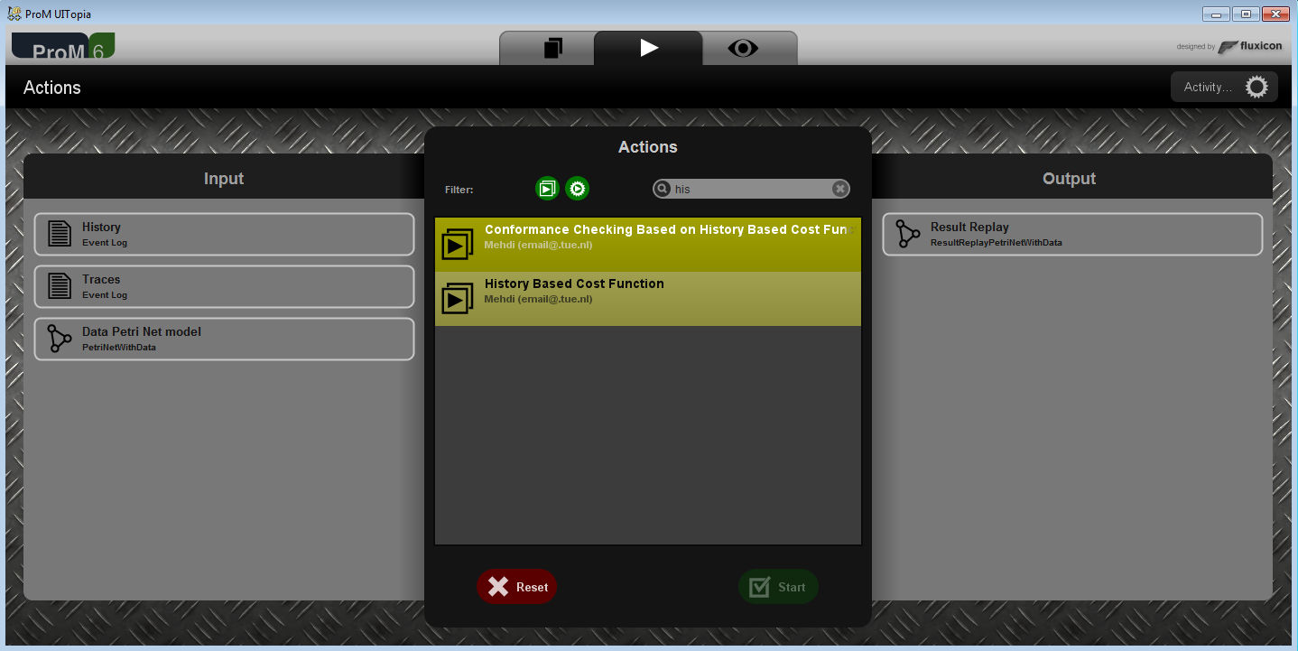
ProM Plugin

Slide 16
Experiments
Synthetic Data
Real-life logs
Process Model
80%
ProM Plugin
Add or remove activities
Most probable alignment
Perfectly fit traces with model
20%
Original Trace: CVAIO
Trace: CVIO
Reconstructed Trace: CVSIO
A is removed
Measuring quality of the alignments:
Percentage of Correct Alignment (CA)
Levenshtein Distance (LD)
Alignment technique when standard cost function is used
Different amounts of noise: 10%, 20%, 30%, 40%
State representation function: Sequence, Multi-set, Set
Cost profiles:

Slide 17
Synthetic Data: Loan Process Management
The type of cost profile
The type of state
representation
Different level
of noise
Percentage of Correct Alignments (CA): +4.2%
Levenshtein Distance (LD): +15.2%

Slide 18
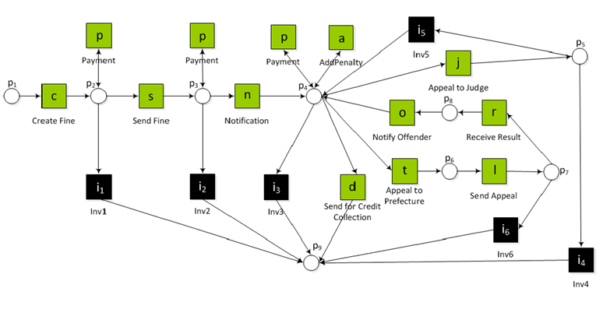
Real-life Logs: Traffic Fine Management Process
Percentage of Correct Alignments (CA): +1.8%
Levenshtein Distance (LD): +21.1%

Slide 19
Alignment
History-Aware Conformance Checking
Evaluation
Future Works

Slide 20
Future Works
History-aware conformance checking
Cost-profile function
Considering other business process perspectives (e.g. data, context, resources)
Severity Cost function (quantification of deviations)

Slide 21
Thanks for your attention.

