Slide 2
Optimization under Uncertainty for Advanced Planning and Scheduling

Slide 3
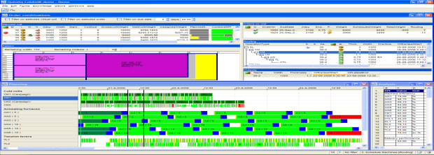
One Software, Many Solutions
Customer Specific Models
Industry Solutions
Quintiq Application Suite
Gantt cache
Change Handler
Daemons
Designer
Authorization
Delta propagation
Undo/Redo
Security
Business Logic Editor
LDAP
Delta Propagation
Session Manager
External Model
Software Transactional Memory
Datasets
Propagator
Transaction Manager
Communication Layer
Internal Storage
Graph Algorithms
Benchmarking
Solomon
Architect
User Administrator
Licensing
Represent- ations
Client
Highlighting
Calendars
Server
Mobility Server
Optimizers
Tools
Selecting Attributes
Standard Features
Reporting
Sorted Relations
CLP Analysis
Path Optimization Algorithm
Deployment
Deployment
Image Attributes
Configure Options
Calendar Editor
Knowledge Tables
Business Logic
Special
GIS Integration
Constraint Logic Program
Persistent Algorithm
Configuration Utility
Filtering
Visualization
Components
Analysis
Methods
Mathematical Program
Log Analyzer
Views
KB Editor
Functions
Integration
POA Analysis
Configuration API
Docking Panels
Chart
Gantt chart
List
Custom Draw
Basic Components
Daemons
Messaging
SOAP
.NET
ODBC
LDAP
Persistent Algorithm
MP Analysis
Log Viewer
Notes:
Owner: Research and Development, Mark Willems

Slide 4
Quintiq Basic Architecture
Java Thin Client
Dispatcher
Windows Client
Presentation Layer
Thin Client
Engine
Dispatcher
Business Layer
Quintiq Server
Data Layer
ODBC
Integrator
ODBC
Integrator
Internal DB
Interface DB
External
system
Notes:
Owner: Research and Development, Mark Willems
Simpler diagram only describing the basic components:
Client tier:
Windows Client + Dispatcher: Dispatcher used to service clients – frees server from communication.
Java Thin Client + Thin Client Engine: Java Thin Client is light weight wrt data.
Server tier:
Server: Calculates and propagates business model.
Data tier:
ODBC Integrator: For integration with ODBC compliant databases (e.g. Oracle, SQL Server, MySQL, DB2, …). Used for internal storage (essential for resilience: no data is lost) and bulk data interfacing (interface database).

Slide 5
Software Features (Overview)
List
Dialog & Basic Components
Custom Draw
Chart
Gantt chart
CLIENT FEATURES
GUI Designer
Business
Logic Editor
System Monitor
Configuration Utility
User & License Administrator
TOOLS
SERVER
FEATURES
Quill
Propagator
Modeling Constructs
Calendars
Knowledge Base
Quill
Constraint Programming
Simulated Annealing
Graph Algorithms
Mathematical Programming
ALGORITHM
OVERVIEW
REPORTING
OVERVIEW
Analysis
Export
Printing
Report
Configuration
SQL Server
Reports
INTEGRATION
OVERVIEW
ODBC
Messaging
SOAP
.NET
File

Slide 6
Goals for the year
Learn about Quintiq, POA, MIP, column generation, Local Search,
Large Neighborhood Search, Constraint Programming (Gecode)
Learn about the Quintiq Optimization code and how it is organized.
Follow courses supporting the research goals.
Doing a literature study on optimization under uncertainty / robust advanced planning and scheduling.
Studying a Quintiq optimization problem:
VRPTW (DHL)
Flexible flow shop problem
Writing a paper about solving this optimization problem.

Slide 7
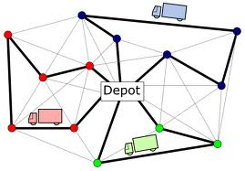
VRPTW

Slide 8
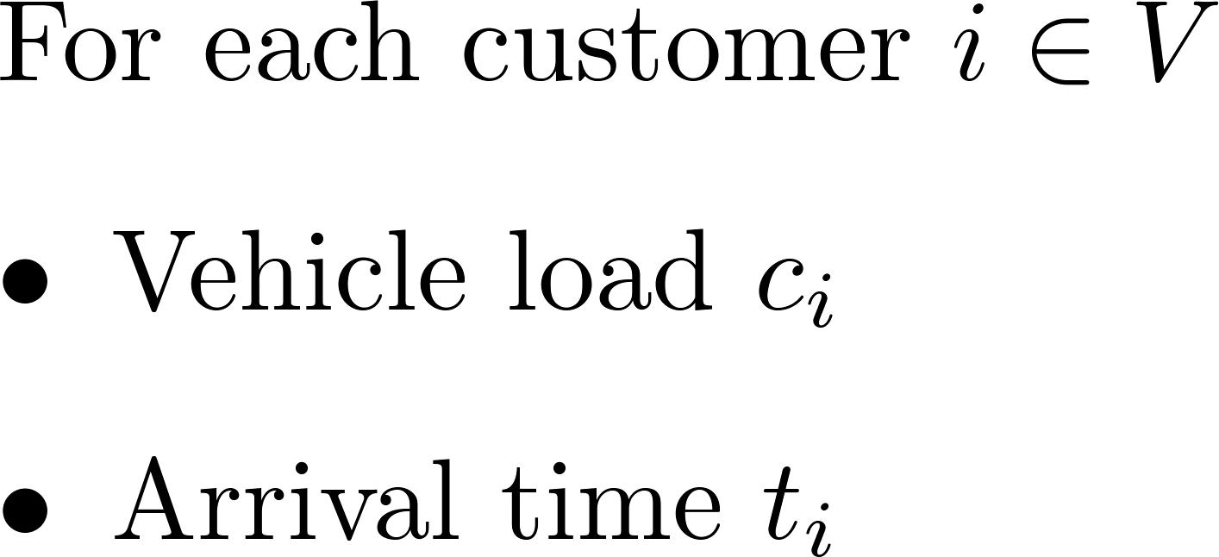
Decision variables

Slide 9
VRPTW Objective

Slide 10
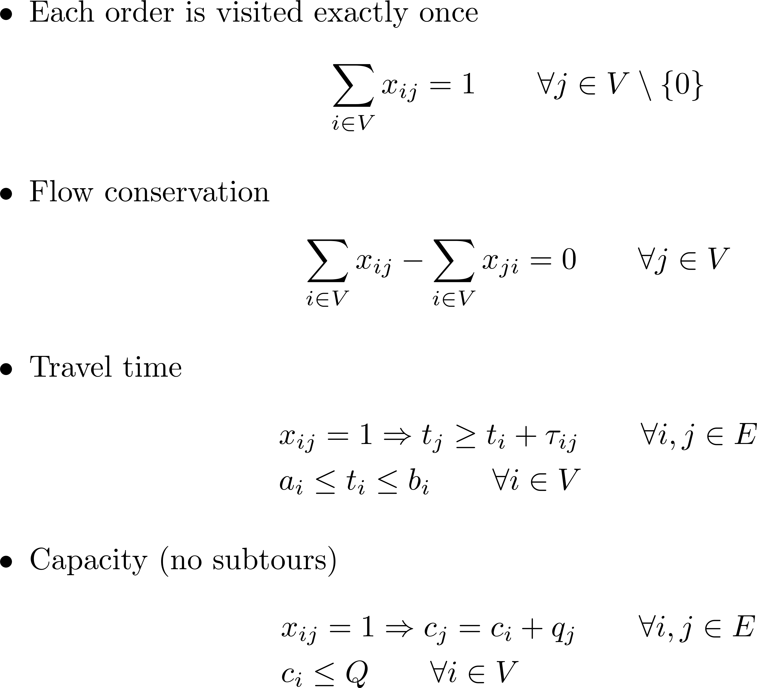
VRPTW constraints:

Slide 11
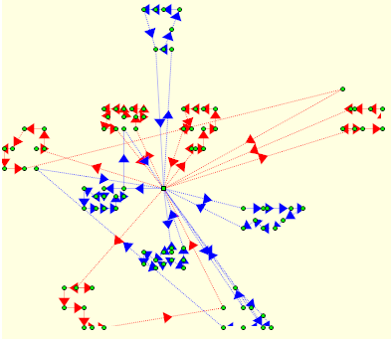
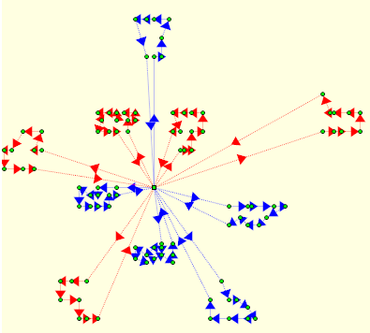
Examples
11 routes, distance 1138.88
10 routes, distance 828.94

Slide 12
Demo

Slide 13
Solutions found in literature
Exact solutions
MIP, Lagrangian relaxation, column generation, branch and cut, dynamic programming
Solves instances to about 100 nodes
Heuristic and meta-heuristics
Genetic algorithms, local search, scatter search and many more.
Able to solve large instance 1000 nodes and upwards, but guarantees no optimality.

Slide 14
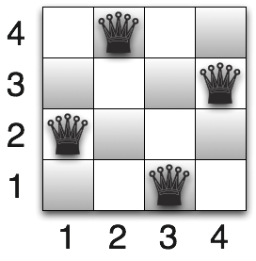
Constraint Programming
Paradigm to solve combinatorial optimization problems.
One states the problem in terms of variables and constraints after which a search procedure is used to find a solution

Slide 15
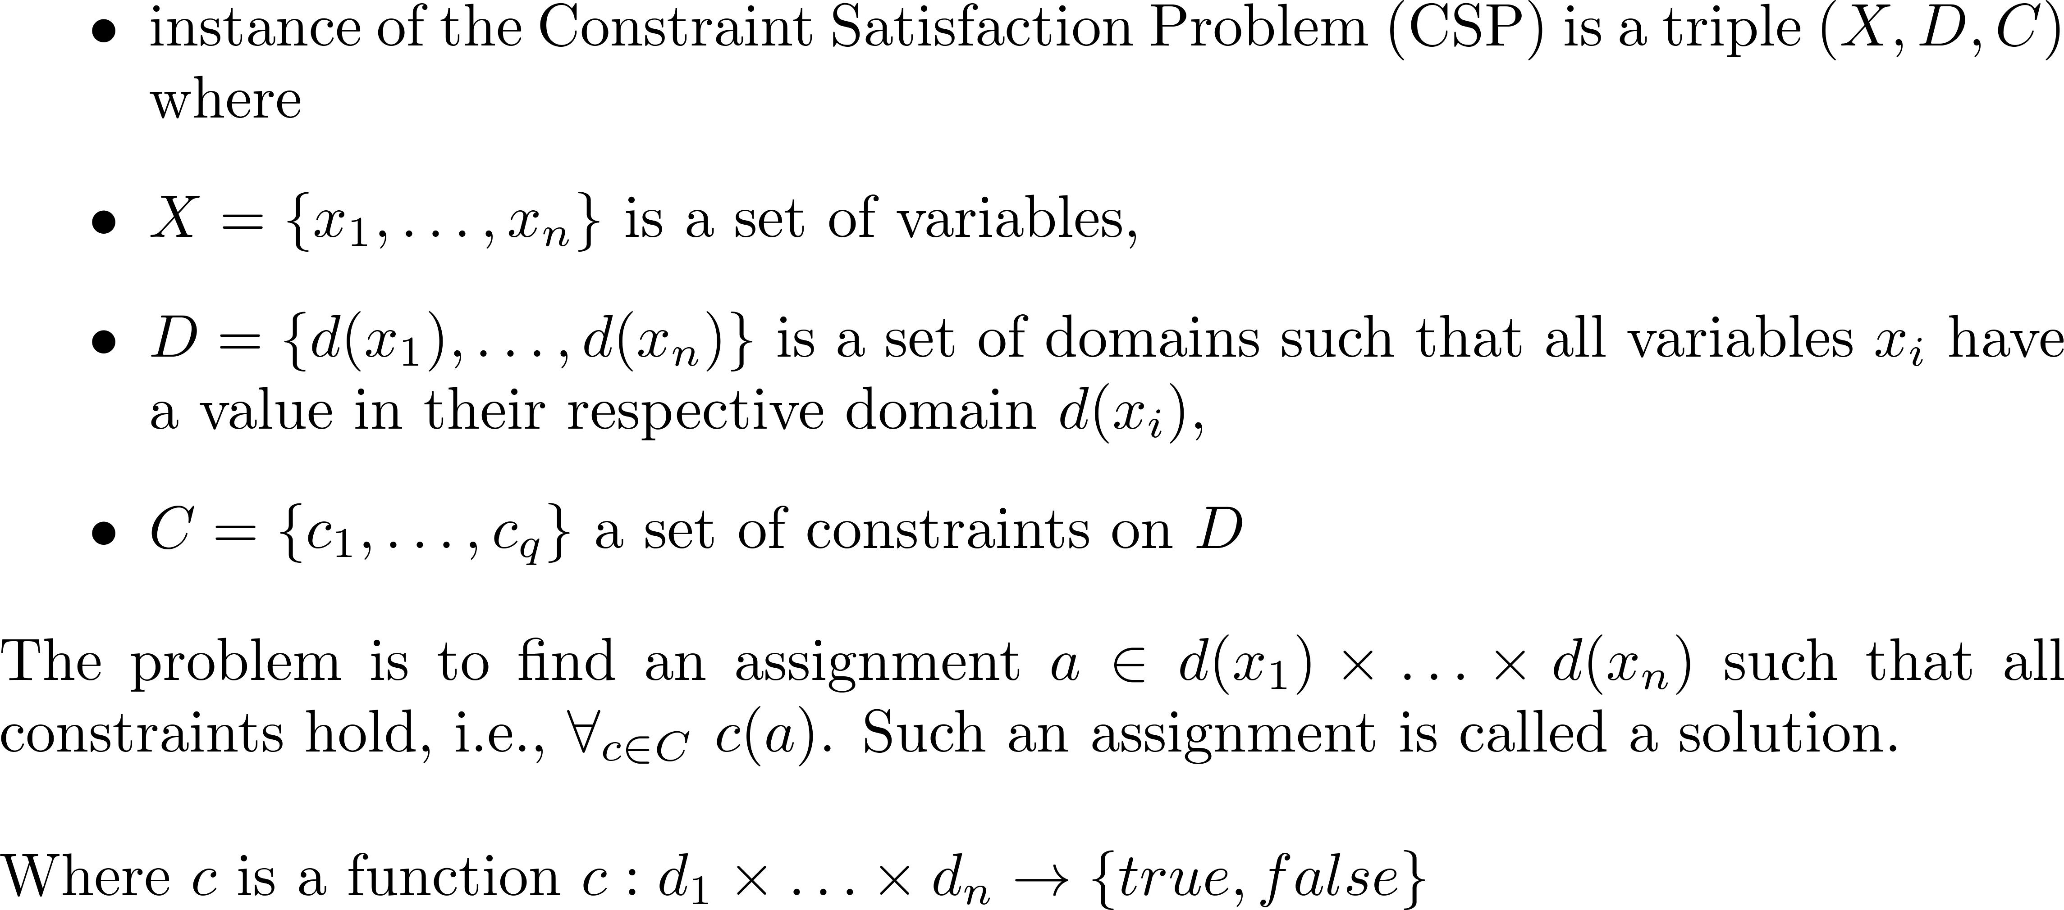
CSP

Slide 16
CP
In a Constraint Optimization Problem we have an objective function value f(a) for each assignment a.
The problem is to find an assignment with optimal (minimal/maximal) objective value

Slide 17
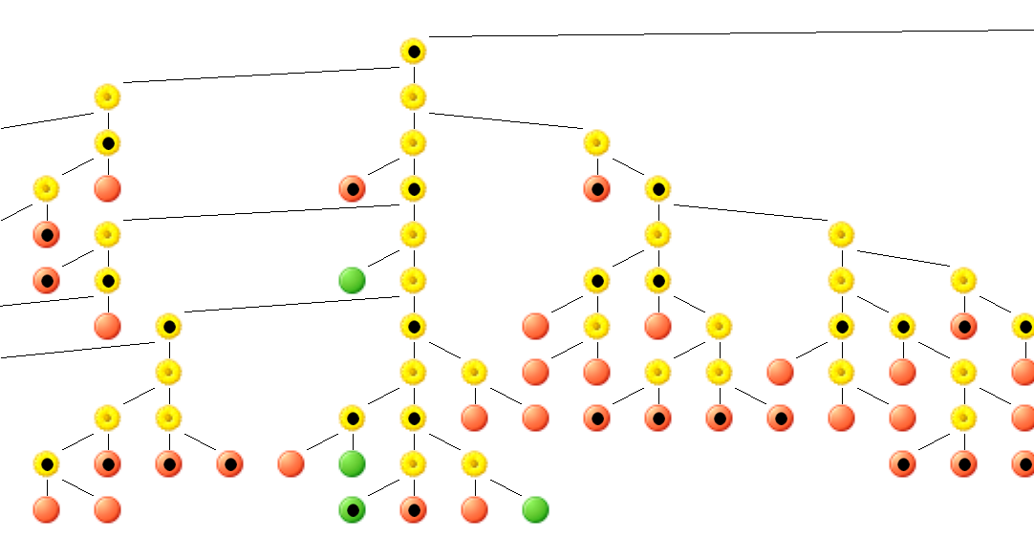
CP Search
Propagation
Backtrack
Add lower/upper bound and backtrack

Slide 18
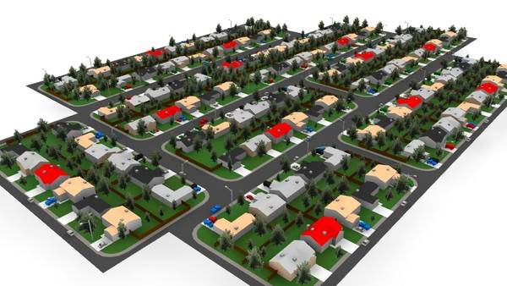
Large Neighboorhood Search (LNS)
Initial solution is gradually improved by alternately destroying and repairing a subset of the solution.
Successfully applied to the VRPTW already in adaptive fashion [PisingerRopke05]
Idea: Use a CP model to
Use propagation to increase the search speed
Be able to add any complex side constraints

Slide 19
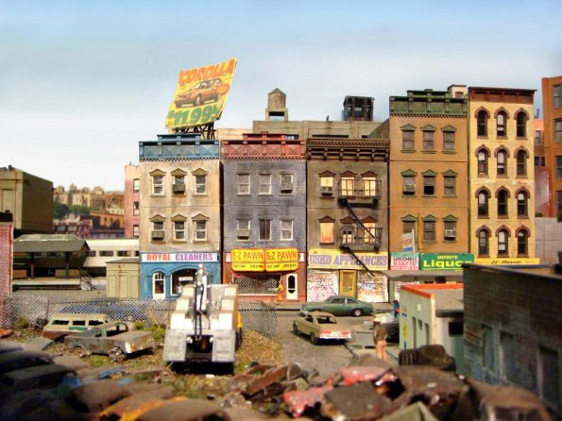
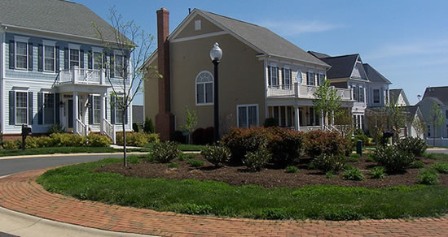
CP LNS
Full CP approach is unable to find even a feasible solution for 30+ customers in reasonable time.
Relax (and constrain) a part of the variables (neighborhood) and optimize these separately
Key decisions
How do you choose the right neighborhood?
How large should it be?

Slide 20
CP LNS Framework
Add new lower bound
Better solution found
Initial solution
Choose
neighboorhood
Relax
Solution
Search
Timeout or
infeasible

Slide 21
Neighboorhoods for the VRPTW
Radius from depot
Random
Nearest customers
Pairs of routes
Segements
Many more

Slide 22
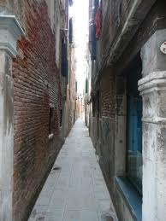
Relaxation strategies
Strict
Only the removed orders are considered (rest of the solution remains fixed)
Loose
Every removed customer visit can potentially be inserted everywhere in the solution
Requires adding a domain constraint during the search

Slide 23
Implemention
In Quintiq using Quill and Gecode interface
Improvements to software
Ability to add constraints during the search
Addition of lazy constraint propagation
Improving performance of user actions
Solved issues
CP model to large for 1000 plus nodes
Current issues:
Memory leak issue in user actions

Slide 24
Preliminary results

Slide 25
Generating routes using DP
A fast polynomial algorithm exists to calculate the s-t monotone shortest path having the highest reward.
Idea: Combine this into set cover/column generation
Demand is reward, collecting more reward costs travel time
Challenge: Find good tradeoff

Slide 26
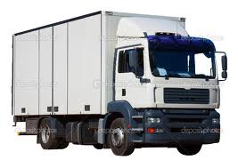
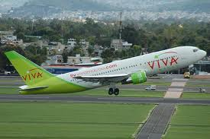
VRPTW with uncertain travel times
For longer routes, probability that you arrive on time decreases
Problem for tight due date constraint
Most optimal scheduling solutions are very tight and therefore not usable in practise

Slide 27
VRPTW with uncertain travel times
Example:
Suppose that we have a route R with 20 stops
The traveltime (m) is normally distributed N(30,2)
There is a hard due time at the last stop of 600 minutes
The arrival time at the last stop is:
The probability you are more than half an hour late is
P(Z > 630) ≈ 0.23

Slide 28
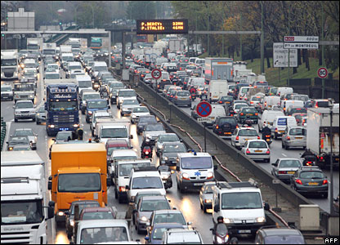
VRPTW with uncertain travel times
Travel time between to locations is typically log normally distributed or derived from statistical data
Difficult to add these exact
Solution: Use approximations
Travel distance against reliability
Additional challenge:
Time dependent travel times
Arrive at each stop k in R with a certain reliability

Slide 29
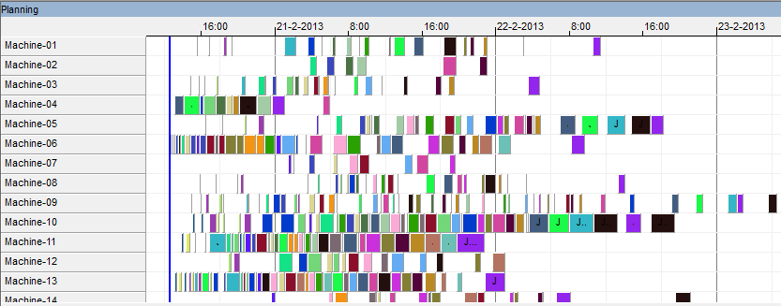
Flexible flow shop problem (FFS)
Set of operations
Set of machines
Each operation is allowed to be executed on a subset of machines
Minimize makespan, subject to:
sequence constraints per job
no overlap of operations per machine

Slide 30
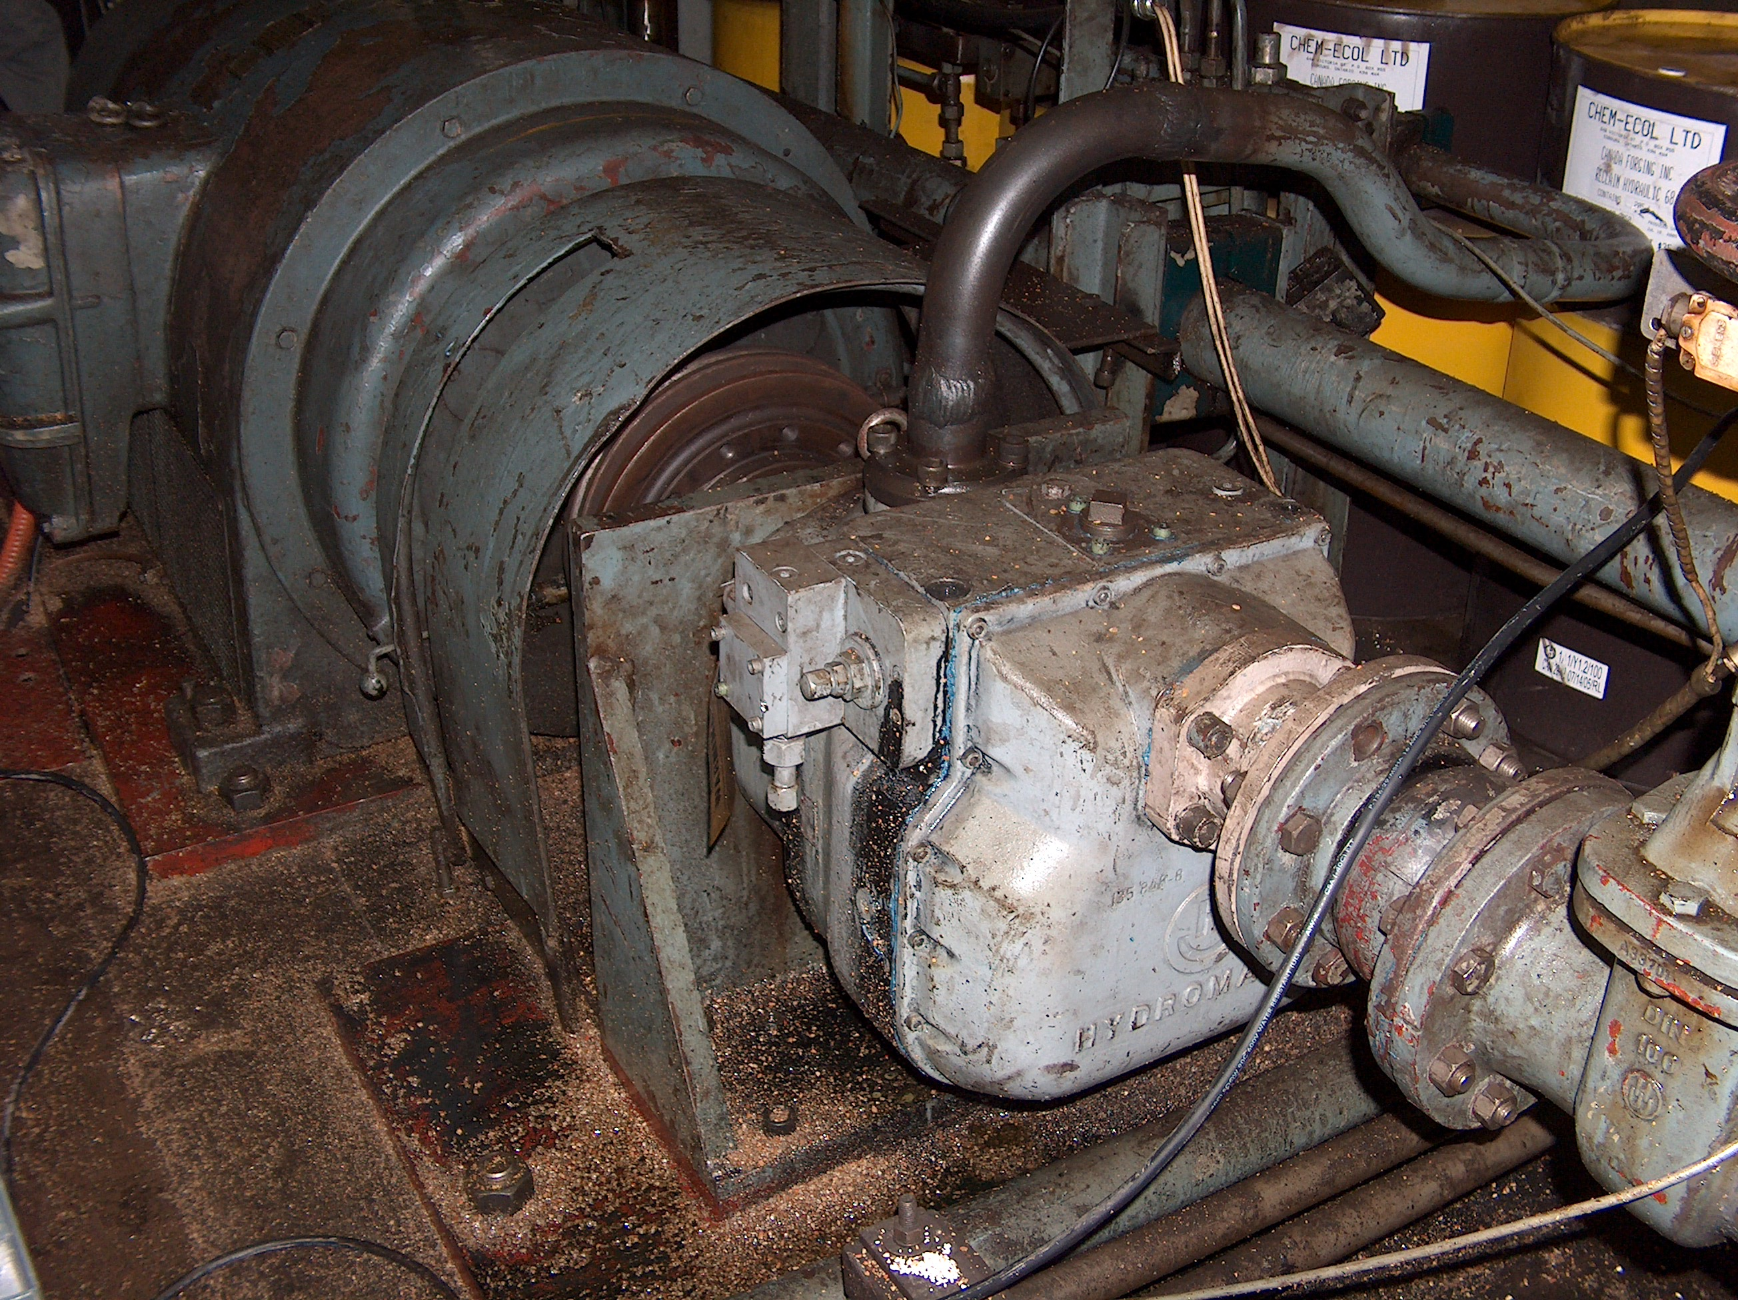
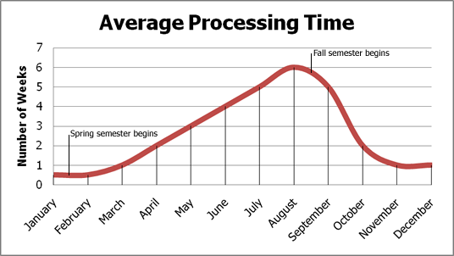
Uncertainty levels FFS
Machine breakdowns
Machine and operation dependent processing times

Slide 31
Conclusion
VRPTW and CP LNS
Promising but needs to be improved
Add cooling schedule instead of hill climbing
Replanning/optimizing a neighborhood should be faster
Increase propagation strength
Experiment with branching strategies
Make it adaptive
Generating s-t routes with dynamic programming
Currently on hold
Add uncertainty levels for VRPTW and FFS

Slide 32
Questions

