Slide 1
Process Multidimensional Analysis
An overview of my current work
4/9/2014
Alfredo Bolt
TU/e

Slide 2
Googling “Multidimensional Analysis”
Wikipedia
Data dimensions & Measurements
Single-dimensional datasets
Notes:
data analysis process that groups data into two or more categories: data dimensions and measurements.

Slide 3
Googling “Multidimensional Analysis”
Wikipedia
Data dimensions & Measurements
Two-dimensional
Notes:
Explain multidimensional
Cup matches vs League matches → another dimension

Slide 4
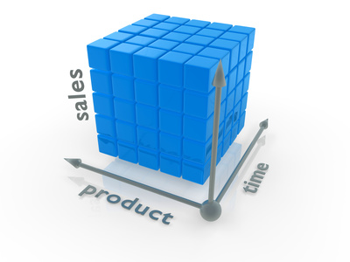
Googling “Multidimensional Analysis”
Wikipedia
Data dimensions & Measurements
Microsoft (HyperCube)
Dimensions & measures
Keyphrase: Aggregation of measurements
Notes:
A cube is a multidimensional structure that contains information for analytical purposes
Dimensions define the structure of the cube that you use to slice and dice over, and measures provide aggregated numerical values of interest to the end user.
A cell, in the cube, is defined by the intersection of dimension members and contains the aggregated values of the measures at that specific intersection.

Slide 5
Why is this important?
Aggregation → Cell
Slice/Dice
Roll-up/Drill-down
Visualization
Fancy flavors
Cell selection
Scope definition
Comparison
Eureka!
Decision Support
Trends
Performance
…

Slide 6
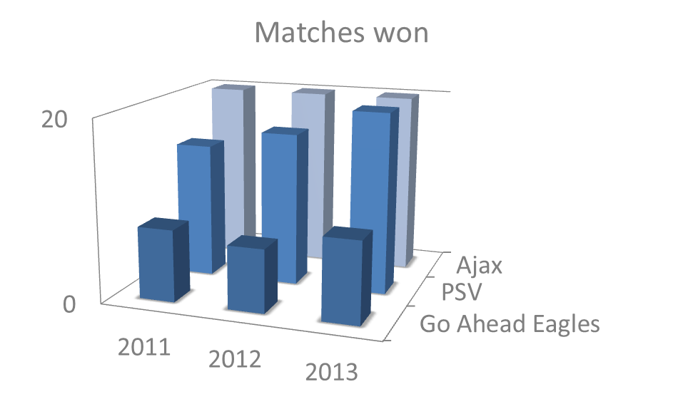
OLAP is a good example for M.A.
On Line Analytical Processing (Cube)
MOLAP / ROLAP / HOLAP
On Line
Summarizability ← Measurements disjoint within dimension
→ Real Time
→ Pre-calculations

Slide 7
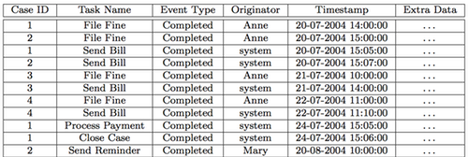
How can we apply this to processes?
Dimensions
(Trace & Event) Attributes
Measurements
Events
Limitations
Summarizability is not
guaranteed
(Trace) Attribute
Event Log
Event
(Event) Attribute

Slide 8
Approaches so far…
Tatiana Mamaliga (TU/e)
ProCube (prototype)
Vogelgesang , Appelrath (University of Oldenburg)
Only theorical
Shengnan Guo (TU/e)
Work in progress (ProM)
Notes:
Tatiana Mamaliga
Prototype
Many bugs
Limited functionalities
Palo OLAP server overhead
Pre-aggregate functions
used for summarizability
In-memory DB
Big Data issues with Multidimensional DBs

Slide 9
PMAC
Stand-alone
Flexible input/output
Performance-wise
Usable
OLAP functions
Slice/Dice/Roll-up/Drill-down
Analysis tools
Process Mining / BPM / BI
Notes:
Key Process Indicators

Slide 10
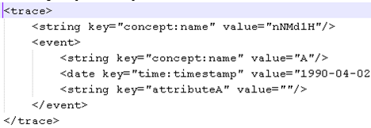
How does my approach work?
Data Import
Flat Event Log
csv / arff / keyvalue
Flat Event Log
XES Event Log
/ xes

Slide 11
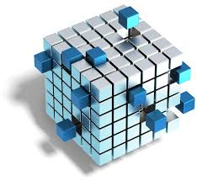
How does my approach work?
Data Import
Flat Event Log
Cell Materialization
Set of (sub)logs
Event
Base
Cell = (sub) log
Scope
Log parameters
Notes:
Log parameters
Dimensions (hierarchies)
Case ID
Activity ID
timestamp

Slide 12
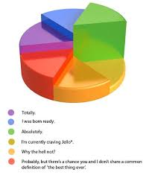
How does my approach work?
Data Import
Flat Event Log
Cell Materialization
Set of (sub)logs
Log Handling
Plugins
XES Log

Slide 13
I like my approach because…
It is flexible and customizable
(sub)log generation
You can plug (almost) anything to it
Try it!
It is faster & stronger
Time-boundness / DB storage
Want to check it out?
Notes:
Seal of approval

Slide 14
I still have to…
Improve the look & feel
Do you feel me?
Add BPM/BI metrics
Calculation & Visualization
Do user testing
Reward for those who help ☺

Slide 15
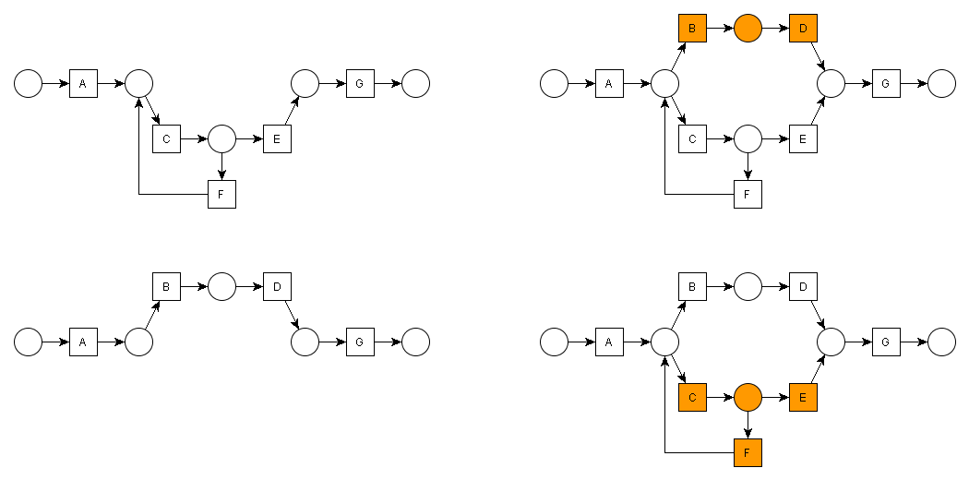
Future work
Visually compare models
Highlight different parts

Slide 16
Future work
Visually compare models
Highlight common parts

Slide 17
Future work
Visually compare models
Why not both?

Slide 18
Future work
Visually compare models
Ideas & collaboration are always welcome!

Slide 19
Questions?

