Slide 1
Scientific Workflows Within the Process Mining Domain
Martina Caccavale
17 April 2014

Slide 2

Outline
Purposes of the project
1.1 Process Mining Analysis Workflow
1.2 Scientific Workflow System
1.3 Simple example of Process Discovery in KNIME (live)
Connection Process Mining and Data Mining
2.1 Two use cases about Data Mining and Process Mining
2.2 Cluster traces
2.3 Repair Log
3. Conclusion

Slide 3
Purposes of the project
Integrate ProM6 into KNIME
Connection between Process Mining and Data Mining using KNIME
Notes:
The purposes are two. Firstly we are going to investigate the reasons that brought me to work on this integration.

Slide 4
Outline
Purposes of the project
1.1 Process Mining Analysis Workflow
1.2 Scientific Workflow System
1.3 Simple example of Process Discovery in KNIME (live)
Connection Process Mining and Data Mining
2.1 Two use cases about Data Mining and Process Mining
2.2 Cluster traces
2.3 Repair Log
3. Conclusion

Slide 5
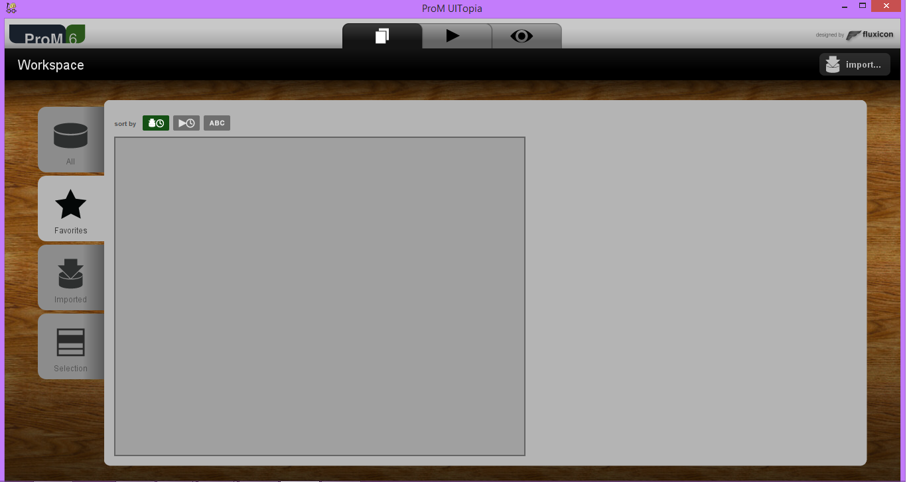
Process Mining Analysis Workflow
Integration of ProM in KNIME

Slide 6
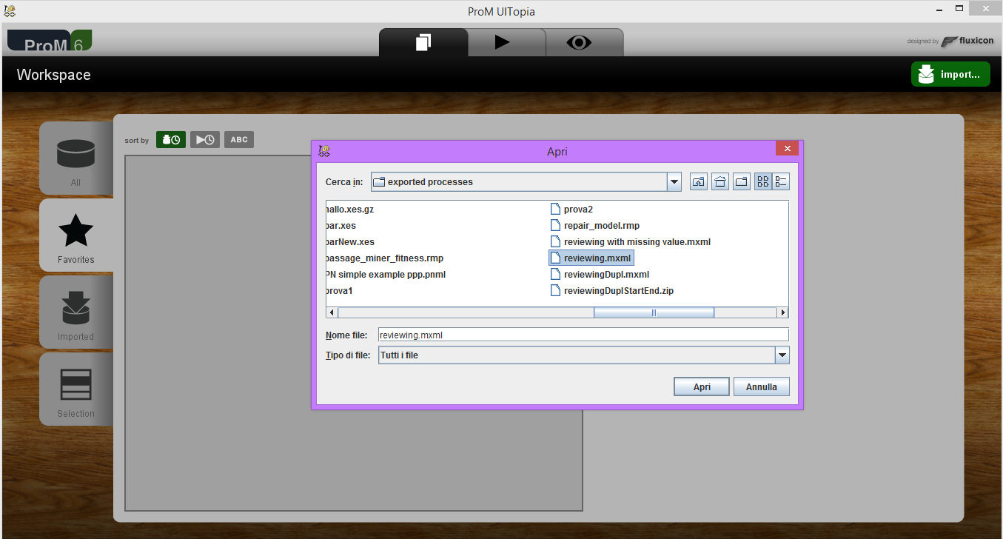
Integration of ProM in KNIME
Process Mining Analysis Workflow
Select log

Slide 7
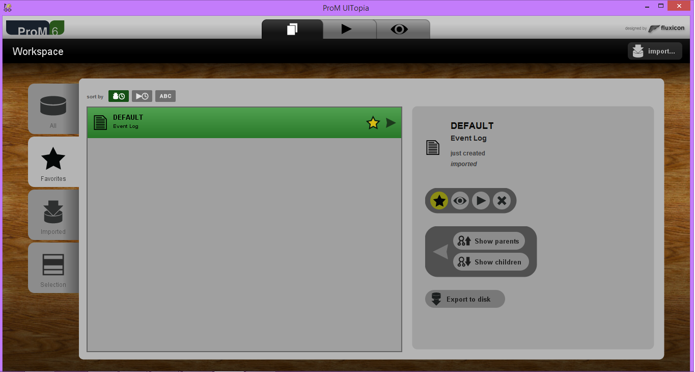
Process Mining Analysis Workflow
Integration of ProM in KNIME
We have the log
e log

Slide 8
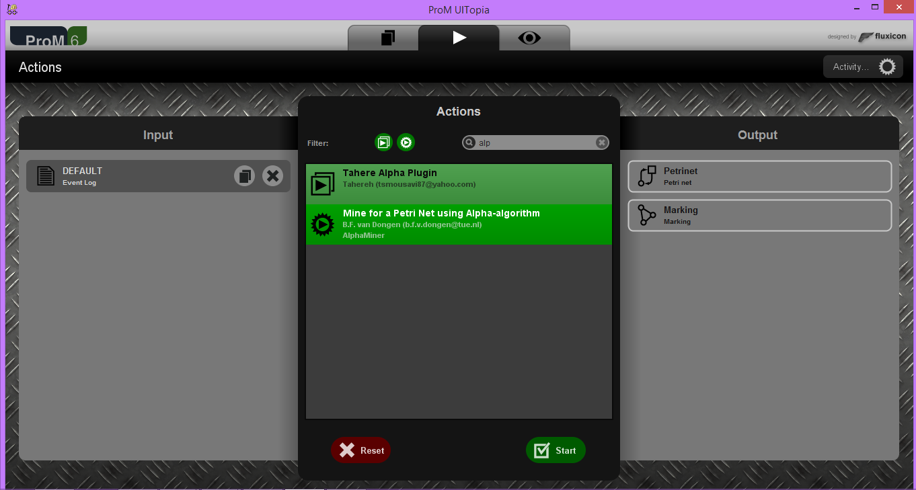
Process Mining Analysis Workflow
Integration of ProM in KNIME
Select Alpha Miner

Slide 9
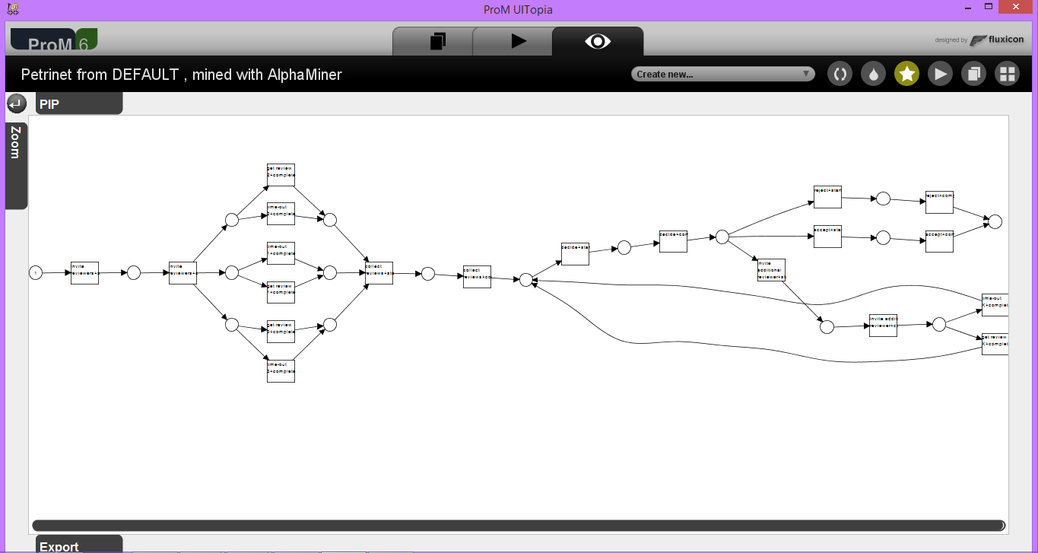
Integration of ProM in KNIME
Process Mining Analysis Workflow
Resulting Petri net

Slide 10
Integration of ProM in KNIME
Often Encountered Issues in ProM
Several intermediate steps are needed
No support for doing experiments
Often the same analysis is performed
Usage of Data Mining / Machine Learning algorithms in ProM
Notes:
So as u saw one issue of Prom is the several steps necessary to get an analysis
With doing experiments I mean that if you want to see the behavior of the analysis with different parameters you need to compose and execute again all the steps,
in healthcare domain the analysis is always the same only change the data processed

Slide 11
Integration of ProM in KNIME
No support for the construction and execution of a workflow which describes all the analysis steps and their order
Solution:
Scientific Workflows
Notes:
so to sum up

Slide 12
Outline
Purposes of the project
1.1 Process Mining Analysis Workflow
1.2 Scientific Workflow System
1.3 Simple example of Process Discovery in KNIME (live)
Connection Process Mining and Data Mining
2.1 Two use cases about Data Mining and Process Mining
2.2 Cluster traces
2.3 Repair Log
3. Conclusion

Slide 13
Scientific Workflow Systems
Scientific Workflow System is designed specifically to:
COMPOSE and EXECUTE a series of computational or data manipulation steps in a scientific application.
provide an EASY-TO-USE way of specifying the tasks that have to be performed during a specific experiment.
Notes:
Compose and THEN execute, in Prom you compose and execute in the same time so this is the first advantage in knime that you can repeat the same analysis only changing one parameter without ri-run it again this is important for example for the ospital when the analysis process could be the same and only the data change

Slide 14
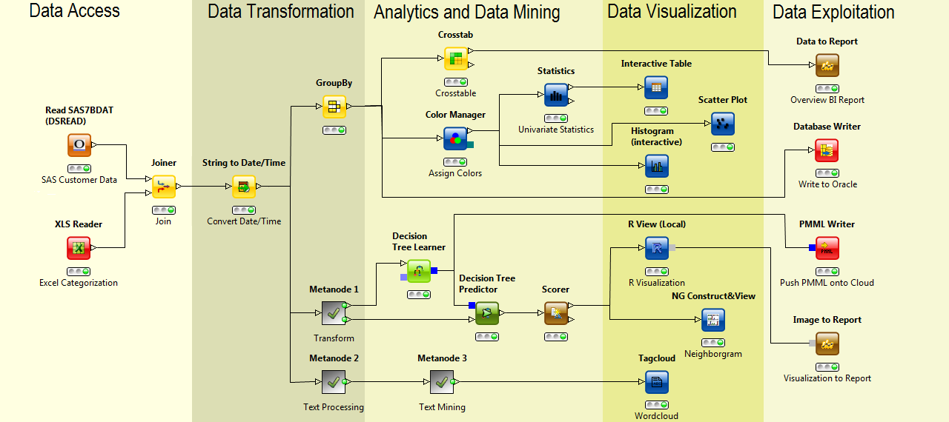
Scientific Workflow Systems
Notes:
This is an example of workflow in KNIME, as you can see it’s made by different steps:
Data Access for the input data, then the manipulation of the data is made, after that some analysis are executed and the visualization and exploitation.

Slide 15
Outline
Purposes of the project
1.1 Process Mining Analysis Workflow
1.2 Scientific Workflow System
1.3 Simple example of Process Discovery in KNIME (live)
Connection Process Mining and Data Mining
2.1 Two use cases about Data Mining and Process Mining
2.2 Cluster traces
2.3 Repair Log
3. Conclusion

Slide 16
Demo

Slide 17
Outline
Purposes of the project
1.1 Process Mining Analysis Workflow
1.2 Scientific Workflow System
1.3 Simple example of Process Discovery in KNIME (live)
Connection Process Mining and Data Mining
2.1 Two use cases about Data Mining and Process Mining
2.2 Cluster traces
2.3 Repair Log
3. Conclusion

Slide 18
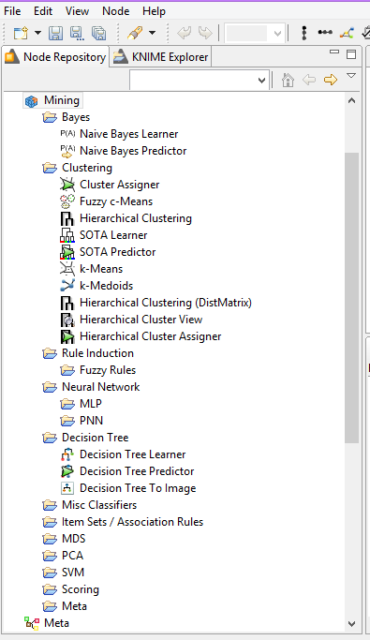
Connection between Data Mining and Process Mining
In ProM to use Data Mining algorithms you have to implement them, in KNIME are already there!
So the question is: What can I do with them that I cannot do in ProM?

Slide 19
Outline
Purposes of the project
1.1 Process Mining Analysis Workflow
1.2 Scientific Workflow System
1.3 Simple example of Process Discovery in KNIME (live)
Connection Process Mining and Data Mining
2.1 Two use cases about Data Mining and Process Mining
2.2 Cluster traces
2.3 Repair Log
3. Conclusion

Slide 20
Outline
Purposes of the project
1.1 Process Mining Analysis Workflow
1.2 Scientific Workflow System
1.3 Simple example of Process Discovery in KNIME (live)
Connection Process Mining and Data Mining
2.1 Two use cases about Data Mining and Process Mining
2.2 Cluster traces
2.3 Repair Log
3. Conclusion

Slide 21
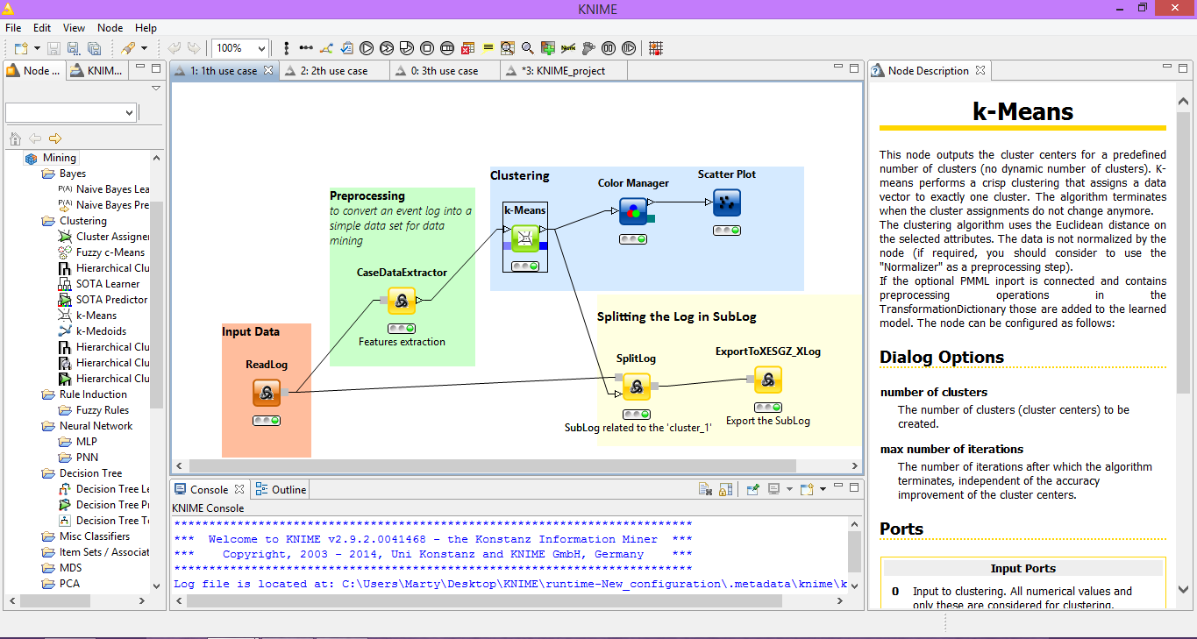
Use case 1: Cluster traces
The purpose is to split the log in sublogs using the clustering of the traces

Slide 22
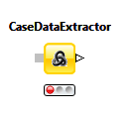
Use case 1: Cluster traces
converts the log in features set:
Per traces :
  Number of events in trace
  Total duration of a trace
  ......
Per events:
  Number of instances
  Relative times from start
  How often the resource X executes the event
  Value of data attribute
  …….

Slide 23
Use case 1: Cluster traces
Each row is a trace
Case ID | T:number of events | T:duration (ms) | E:get review1 number of instances | E:get review1 relative time | E:get review1 complete Anna | E:data get review1 Result by Reviewer A
1 | 26 | 8812800000 | 1 | 864000000 | 1 | Reject
2 | 41 | 108864000000 | 0 | ? | 0 | ?
3 | 36 | 79747200000 | 1 | 518400000 | 0 | Accept

Slide 24
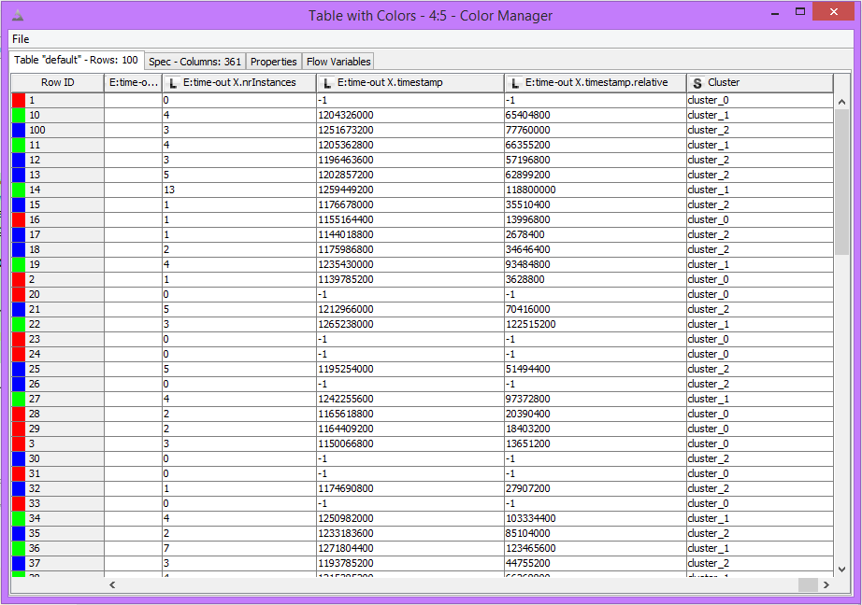
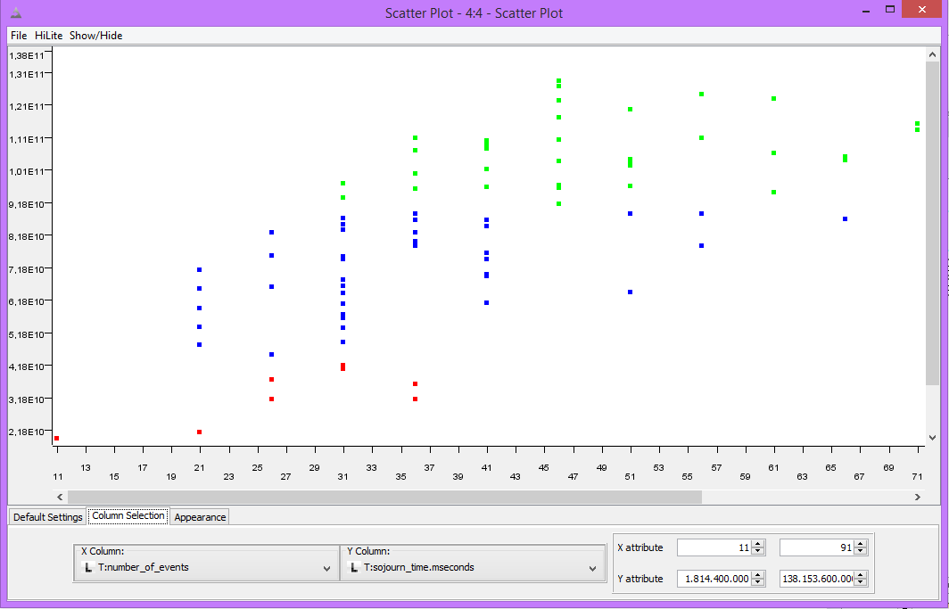
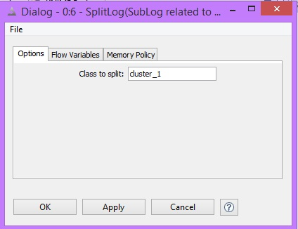
Use case 1: Cluster traces
Nodes for data visualization

Slide 25
Outline
Purposes of the project
1.1 Process Mining Analysis Workflow
1.2 Scientific Workflow System
1.3 Simple example of Process Discovery in KNIME (live)
Connection Process Mining and Data Mining
2.1 Two use cases about Data Mining and Process Mining
2.2 Cluster traces
2.3 Repair Log
3. Conclusion

Slide 26
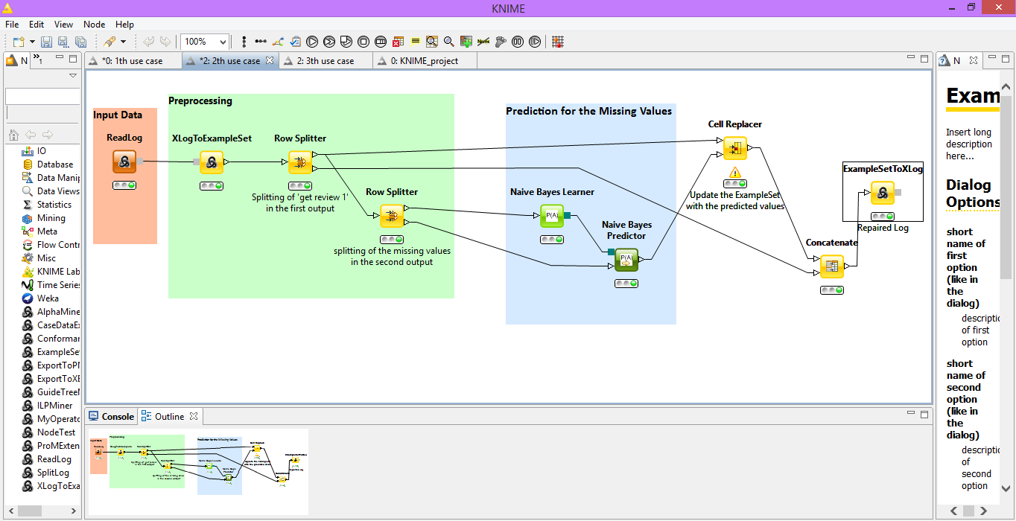
Use case 2: Repair Log
The purpose is to predict the missing values contained in the log using Naïve Bayes predictor

Slide 27

Use case 2: Repair Log
Column with some missing values corresponding to the event ‘get review 1’
                converts the log to table
                Every event is a row
Case ID | E:concept name | E:lifecycle transition | E:org resource | E: time. timestamp | E:Result by Reviewer A | E:Result by Reviewer B
1 | invite reviewers | start | Mike | 01 Jan 2006 00:00:00 CET
1 | invite reviewers | complete | Mike | 06 Jan 2006 00:00:00 CET
1 | get review2 | complete | Carol | 09 Jan 2006 00:00:00 CET |  | Reject
1 | get review1 | complete | John | 10 Jan 2006 00:00:00 CET | MISSING
1 | get review1 | complete | Anne | 12 Jan 2006 00:00:00 CET | Accept

Slide 28
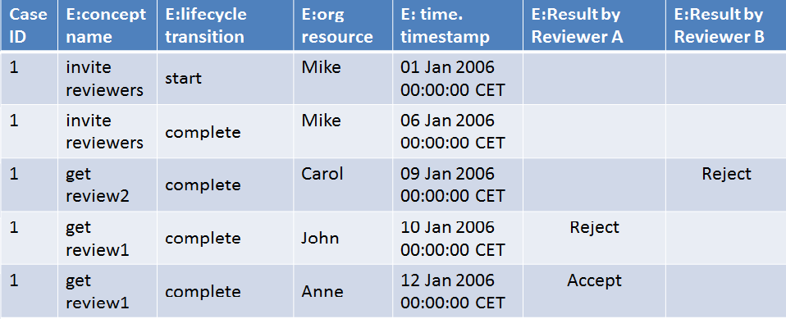
Use case 2: Repair Log
Purpose
Give all the data attributes with values to the Naïve Bayes Learner
Give all the data attributes with missing values to the Naïve Bayes Predictor
Table update with the predicted values

Slide 29
Outline
Purposes of the project
1.1 Process Mining Analysis Workflow
1.2 Scientific Workflow System
1.3 Simple example of Process Discovery in KNIME (live)
Connection Process Mining and Data Mining
2.1 Two use cases about Data Mining and Process Mining
2.2 Cluster traces
2.3 Repair Log
3. Conclusion

Slide 30
Conclusion
Support for the construction and execution of a workflow which describes all the analysis steps and their order is made
Execution time of the Process Mining Analysis WorkFlow is reduced
Connection between Process Mining and Data Mining
  Dragging and dropping
  Analyses/data modification techniques are now possible on the event log

Slide 31
Future Work
Implement more ProM plugins
Invent new use cases
  Text Mining
Make software available for users
Some ideas?

Slide 32

Questions? /Discussion

Slide 33
Thanks for the attention

